Slide 1

Core Java

Slide 2
Agenda
In this session, you will learn about:
Object-Oriented Programming (OOP)
The Way Java Works
Variables
Class and Instance
Constructors
Encapsulation
Inheritance
Polymorphism
Overloading and Overriding
Arrays

Slide 3
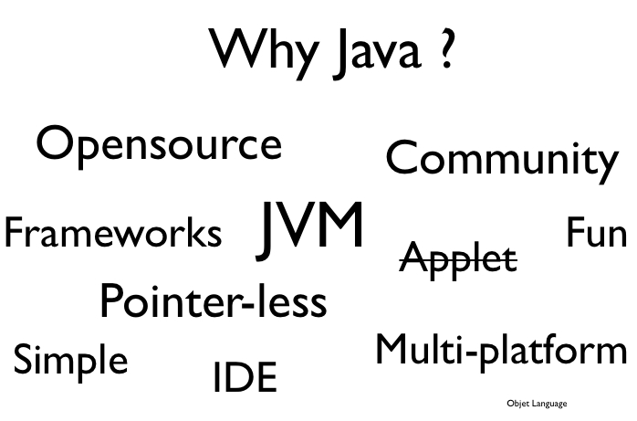

Introduction

Slide 4
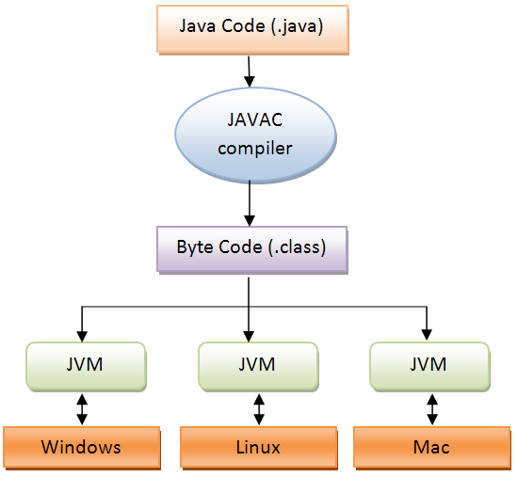
Jdk JRE JVM

Slide 5
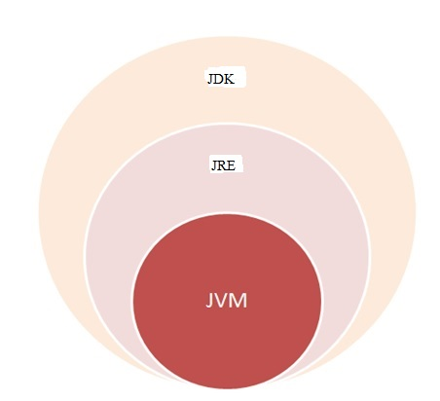
Jdk JRE JVM

Slide 6
JDK JRE JVM
JDK
Java Development Kit
JRE
Java Runtime Environment
JVM
Java Virtual Machine
Notes:
JRE – Java Runtime Environment
JDK – Java Development Kit
JVM – Java Virtual Machine

Slide 7
Java Virtual Machine
A Java virtual machine (JVM) is a process virtual machine that can execute Java byte code.
It is the code execution component of the Java platform.
JVM
FEATURES
Although the JVM was primarily aimed at running compiled Java programs, many other languages can now run on top of it.
The JVM verifies all byte code before it is executed.
Notes:
A Java virtual machine (JVM) is a process virtual machine that can execute Java byte code.
It is the code execution component of the Java platform.
Although the JVM was primarily aimed at running compiled Java programs, many other languages can now run on top of it.
The JVM verifies all byte code before it is executed.

Slide 8
IDE
NetBeans
Eclipse
Jcreator
Processing
Components
BlueJ
MyEclipse
JDeveloper
Notes:
NetBeans
Eclipse
Jcreator
Processing
BlueJ
MyEclipse
JDeveloper

Slide 9

The Way Java Works

Slide 10
The Way Java Works
Create a source document. Use an established protocol.
Run your document through a source code complier. The complier checks for errors and won't let you compile Until it's satisfied that everything will run Correctly.
The compiler creates a new document, coded into Java bytecode. Any device capable of running Java will be able to Interpret/translate this file into something It can run.
The complied bytecode is platform Independent.
.
Your friends don't have a physical Java Machine, but they all have a virtual Java machine (implemented In software) running inside their electronic gadgets. The virtual machine reads and runs the bytecode.
Notes:
Create a source document. Use an established protocol.
Run your document through a source code complier. The complier checks for errors and won't let you compile Until it's satisfied that everything will run Correctly.
The compiler creates a new document, coded into Java bytecode. Any device capable of running Java will be able to Interpret/translate this file into something It can run.
The complied bytecode is platform Independent.
Your friends don't have a physical Java Machine, but they all have a virtual Java machine (implemented In software) running inside their electronic gadgets. The virtual machine reads and runs the bytecode.

Slide 11
The Way Java Works
public class MyFirstApp {
public static void main (String[] args) {
System.out.print(“I Rule!”);
}
}
Public=>public so everyone can access it.
Class=>this is a class.
MyFirstApp=>class name.
{=>opening curly brace of class.
Static=>we’ll cover this later.
Void=>the return type void means there is no return value.

Slide 12
The Way Java Works
Main | Name of the this method
String[] args | Arguments to the method. This method must be given an array of strings,and the array will be called ‘args’.
{ | Opening brace of the method
System.out.print | Print to standard output
I Rule | The string you want to print
; | Every statement must end in a semicolon
} | Closing brace of the main method
} | Closing brace of the MyFirstapp class
Notes:
Main=> name of the this method.
(String[] args)=> arguments to the method. This method must be given an array of strings,and the array will be called ‘args’
{=> opening brace of the method
System.out.print=> this says print to standard output
(“I Rule!”)=> the string you want to print
;=> every statement must end in a semicolon!!
}=> closing brace of the main method
}=> closing brace of the MyFirstapp class

Slide 13
Variables

Slide 14
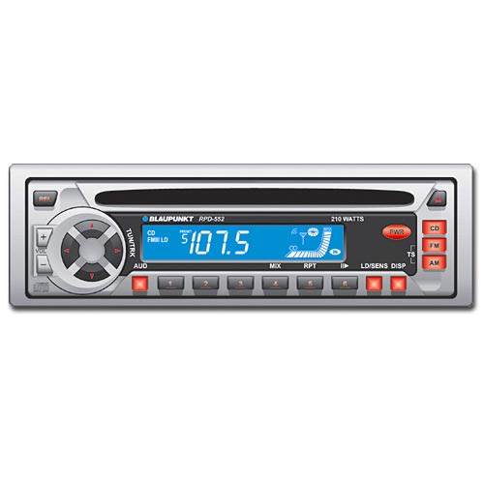
Variables
variable: A piece of your computer's memory that is given a name and type and can store a value.
Usage:
compute an expression's result
store that result into a variable
use that variable later in the program
Unlike a calculator, which may only have enough to store a few values, we can declare as many variables as we want.
Variables are a bit like preset stations on a car stereo.
Notes:
Variables come in two flavors: primitive and reference.
variables must have a type
variables must have a name
Int count;
Int=> type
Count=> name
A variable is just a box. A container. It holds something.

Slide 15

Variables
Variables come in two flavors.
Variables must have a type and a name.
Int count;
Int=> type
Count=> name
Variables
Primitive
Reference
A variable is just a box. A container. It holds something.
Notes:
Variables come in two flavors: primitive and reference.
variables must have a type
variables must have a name
Int count;
Int=> type
Count=> name
A variable is just a box. A container. It holds something.

Slide 16
Primitive Types
Type BitDepth Value Range
boolean and char
boolean (JVM specific) true or false
char 16 bits 0 to 65535
Numeric (all are signed)
Integer
byte 8 bits -128 to 127
short 16 bits -32768 to 32767
int 32 bits -2147483648 to 2147483647

Slide 17
Primitive Types
Primitive Long 64bits
(huge to huge)
Number
Floating Point
Float
32 bits varies
Double
64 bits varies
Notes:
Long 64 bits -huge to huge
floating point
float 32 bits varies
double 64 bits varies

Slide 18
Primitive Types
Primitive declarations with assignments:
Int x;
x = 234;
byte b = 89;
boolean isfun = true;
double d = 3456,98;
char c ='f‘;
lnt z e x;
boolean isPunkRock;
isPunkRock= false;
boolean powerOn;

Slide 19
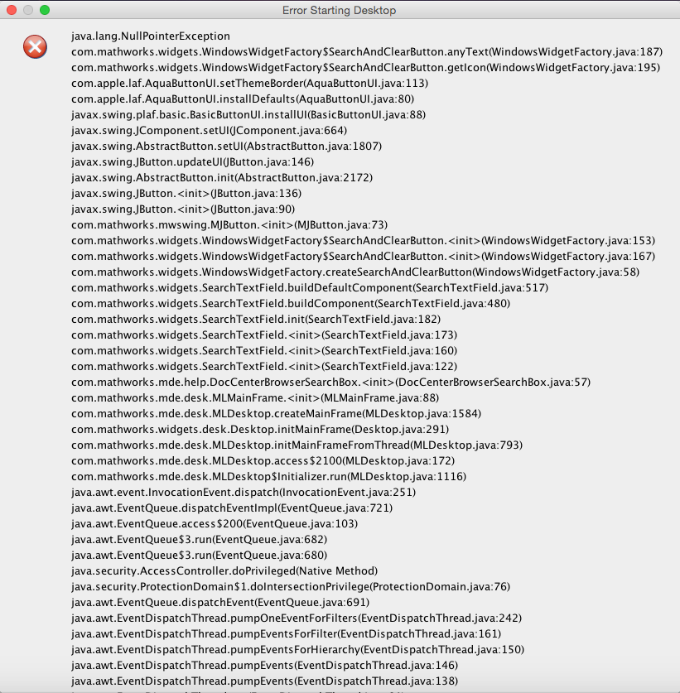

Example
Int x = 24; byte b = x;
//won’t work!!

Slide 20
Keywords
Boolean | Byte | Char | Double | Float | Int | Long | Short | Public | Private
Protected | Transient | Final | Native | Static | If | Interface | This | Volatile | Void
Abstract | For | Switch | Assert | Implements | Else | New | Catch | Return | Const
Synchronised | Break | Case | Class | Import | Do | Package | Finally | Throws | Goto
Strictfp | Continue | Default | Extends | Instanceof | While | Super | Try | Throw | Enum

Slide 21
Object
The 3 steps of object declaration, creation and assignment
Dog myDog = new Dog ()
Declare a reference variable
Dog myDog = new Dog ()
Create an object
Dog myDog = new Dog ()
Link the object and the reference
Dog myDog = new Dog ()
Notes:
The 3 steps of object declaration, creation and assignment
Dog myDog = new Dog () ;
Declare a reference variable
Dog myDog = new Dog () ;
Create an object
Dog myDog = new Dog () ;
Link the object and the reference
Dog myDog = new Dog () ;

Slide 22
Array
Declare an int array variable. An array variable is a remote control to an array object.
int [] nums;
Create a new int array with a length of 7, and assign it to the previously-declared int [] variable nums
nums = new int[7] ;
Give each element in the array an int value. Remember, elements in on int array are just int variables.
Notes:
Declare an int array variable. An array variable is a remote control to an array object.
int [] nums;
Create a new int array with a length of 7, and assign it to the previously-declared int [] variable nums
nums = new int[7] ;
Give each element in the array an int value. Remember, elements in on int array are just int variables.

Slide 23
Array
Arrays are always objects, whether they're declared to hold primitives
or object references.
nums [0] = 6;
nums [1] = 19;
nums [2] = 44;
nums [3] = 42;
nums [4] = 10;
nums [5] = 20;
nums [6]= 1;
Notes:
nums [0] = 6;
nums [1] = 19;
nums [2] = 44;
nums [3] = 42;
nums [4] = 10;
nums [5] = 20;
nums [6]= 1;
Arrays are always objects, whether they're declared to hold primitives or object references.

Slide 24
Objects
A class describes what an object knows and what object does.
Song
Title Artist
setTitle() setArtist() Play()
Instance Variables
(State)
Knows
Methods
(Behavior)
Does

Slide 25
Method
You can send things to method.
A method uses parameters. A caller passes arguments.
If a method takes a parameter, you must pass it something.
void bark (int numfbarks) {
while (numOfBarks > 0) {
System.out.println("ruff");
numOfBarks = numOfBarks - 1;
}
}
Notes:
You can send things to method
A method uses parameters. A caller passes arguments.
If a method takes a parameter, you must pass it something.
void bark (int numfbarks) {
while (numOfBarks > 0) {
System.out.println("ruff");
numOfBarks = numOfBarks - 1;
}
}

Slide 26
You Can Get Things Back from a Method
Void go () {
}
int givesecret () {
}

Slide 27
You Can Send More Than One Thing to a Method
Calling a two-parameter method, and sending it two argument
void go () {
TestStuff t = new TestStuff ;
t.takeTwo(12, 34) ;
}
void takeTwo (int X, int Y) {
int Z = X + Y;
System.out.println (“Total is” + Z) ;
}

Slide 28
You Can Send More Than One Thing to a Method
You can pass variables into a method, as long as the variable type matches the parameter type.
void go () {
int foo = 7;
int bar = 3;
t. takeTwo (foo, bar) ;
}
void takeTwo (int X, int Y) {
int Z= X + Y;
System.out.printLn (“Total is” + Z);
}

Slide 29
Instance Variables
Instance variables always get a default value.
If you don't explicitly assign a value to an instance variable, or you don't call a setter method, the instance variable still has a value!
integers 0
floating points 0.0
booleans false
Notes:
Instance variables always get a default value. If you don't explicitly assign a value to an instance variable, or you don't call a setter method, the instance variable still has a value!
integers 0
floating points 0.0
booleans false

Slide 30
The Difference Between Instance & Local Variables
Instance variables are declared inside a class but not within a method.
class Horse
{
private double height
private String breed;
II more code . . .
}
Notes:
Instance variables are declared inside a class but not within a method.
class Horse
{
private double height
private String breed;
II more code . . .
}

Slide 31
The Difference Between Instance & Local Variables
Local variables are declared within a method.
class AddThing
{
int a;
int b = 12;
public int add()
{
int total = a + b;
return total;
}
}
Notes:
Local variables are declared within a method.
class AddThing
{
int a;
int b = 12;
public int add()
{
int total = a + b;
return total;
}
}

Slide 32
Comparing Variables (Primitives or References)
To compare two primitives, use the == operator
int a = 3;
byte b = 3;
If (a == b) { // true }
Notes:
To compare two primitives, use the == operator
int a = 3;
byte b = 3;
If (a == b) { // true }

Slide 33
Converting a String to an Integer
Integer.parseInt(“3”);
Integer -> Class
parseInt -> Method
“3” -> number in string format

Slide 34
For Loops
The code to Post-increment operator repeat goes:
(the body)
For(int i = 0; i < 100; i++) { ]
Initialization Boolean Test Iteration Expression
Notes:
The code to
Post-increment operator repeat goes
(the body)
For(int i = 0; i < 100; i++) { ]
Initialization Boolean Test Iteration Expression

Slide 35
For Loops
++ --
Pre and Post Increment/Decrement Operator
The shorcut for adding or subtracting 1 from a variable
X++
Is the same as;
X = X + 1
They both means the same thing in this context:
Add 1 to the current value of x
Increment x by 1
OR
Notes:
++ --
Pre and Post Increment/Decrement Operator
The shorcut for adding or subtracting 1 from a variable
X++;
Is the same as;
X = X + 1 ;
They both means the same thing in this context:
‘add 1 to the current value of x” or “increment x by 1”

Slide 36
For Loops
++ --
Pre and Post Increment/Decrement Operator
The shorcut for subtracting 1 from a variable
X--;
Is the same as;
X = X - 1
Notes:
++ --
Pre and Post Increment/Decrement Operator
The shorcut for adding or subtracting 1 from a variable
X++;
Is the same as;
X = X + 1 ;
They both means the same thing in this context:
‘add 1 to the current value of x” or “increment x by 1”

Slide 37
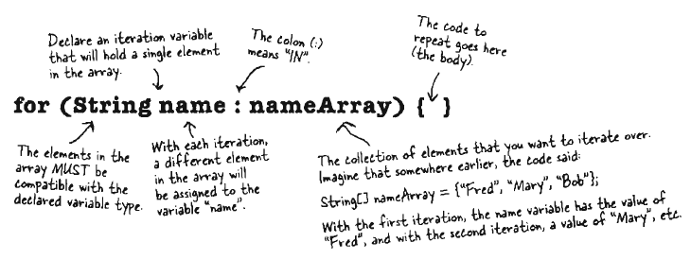
Enhanced for Loop

Slide 38
Casting primitives
long Y = 42;
int X = Y
//won’t compile
long Y = 42
// so far so good
iny X =(int) Y
X + 42 cool!
Notes:
long Y = 42;
int X = Y; //won’t compile
long Y = 42; // so far so good
iny X =(int) Y; // X + 42 cool!

Slide 39
Boolean Expressions
‘And’ and ‘Or’ Oprators ( &&, ll )
if (price >= 300 && Prise , 400) {
camera = “X” ;
}
if (brand.equals 9’A”) ll brand.equals (“b”) ) {
// bdo stuff for only brand A or Brand B
}
Notes:
And’ and ‘Or’ oprators ( &&, ll )
if (price >= 300 && Prise , 400) {
camera = “X” ;
}
if (brand.equals 9’A”) ll brand.equals (“b”) ) {
// bdo stuff for only brand A or Brand B
}

Slide 40
Boolean Expressions
Not equals ( != and ! )
If (model ! = 2000) {
// do non-model 200 stuff
}
If (1Brand.equals(“X”) ) {
// do non-brand X stuff
}
Notes:
Not equals ( != and ! )
If (model ! = 2000) {
// do non-model 200 stuff
}
If (1Brand.equals(“X”) ) {
// do non-brand X stuff
}

Slide 41
Library (the Java API)
In the Java API, classes are grouped into packages.
To use a class in the API, you have to know which package the class is in.
IMPORT
put an import statememt at the top of your source code file:
import java.until.ArrayList;
public class MyClass { . . . }
Imprortb java.until.*;
Classes
Packages
Notes:
In the Java API, classes are grouped into packages.
To use a class in the API, you have to know which package the class is in.
IMPORT
put an import statememt at the top of your source code file:
import java.until.ArrayList;
public class MyClass { . . . }
Imprortb java.until.*;

Slide 42
Object-Oriented Programming (OOP)

Slide 43
OOPs….
Classes
Object
Abstraction
Encapsulation
Object Oriented Programming System
Data Hiding
Inheritance
Polymorphism
Notes:
Object Oriented Programming System.
Classes
Object
Encapsulation
Abstraction
Data Hiding
Inheritance
Polymorphism

Slide 44
Introduction to OOP
Object-Oriented Programming (OOP)
Inheritance: Form of software reusability
New classes created from existing ones
Absorb attributes and behaviors, and add in their own
Override methods: Redefine inherited methods. Subclass inherits from superclass:
Superclass:
Subclass explicitly inherits
Subclass inherits from two or more levels up the class hierarchy
Direct superclass
Indirect superclass
Notes:
Inheritance - form of software reusability
New classes created from existing ones
Absorb attributes and behaviors, and add in their own
Override methods - redefine inherited methods
Subclass inherits from superclass
Direct superclass - subclass explicitly inherits
Indirect superclass - subclass inherits from two or more levels up the class hierarchy
Polymorphism - Write programs in a general fashion to handle a wide variety of classes
Abstraction - seeing the big picture

Slide 45
Introduction to OOP
Object-Oriented Programming (OOP)
Polymorphism : Write programs in a general fashion to handle a wide variety of classes
Abstraction: Seeing the big picture
Notes:
Inheritance - form of software reusability
New classes created from existing ones
Absorb attributes and behaviors, and add in their own
Override methods - redefine inherited methods
Subclass inherits from superclass
Direct superclass - subclass explicitly inherits
Indirect superclass - subclass inherits from two or more levels up the class hierarchy
Polymorphism - Write programs in a general fashion to handle a wide variety of classes
Abstraction - seeing the big picture

Slide 46
Introduction (contd)
Object-Oriented Programming
Introduce protected member access
Relationships
"is a" - inheritance
Object of subclass "is a" object of the superclass
"has a" - composition
Object "has a" object of another class as a member
Class libraries
New classes can inherit from them.
Someday software may be constructed from standardized, reusable components (like hardware).
Create more powerful software
Notes:
Introduce protected member access
Relationships
"is a" - inheritance
Object of subclass "is a" object of the superclass
"has a" - composition
Object "has a" object of another class as a member
Class libraries
New classes can inherit from them
Someday software may be constructed from standardized, reusable components (like hardware)
Create more powerful software

Slide 47
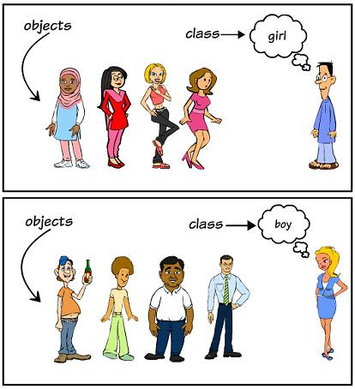
Class and Object

Slide 48
Stack and Heap
Java has two areas of memory:
Stack
Heap
Local variables are variables declared inside a method or method parameter. All local variables live on the stack, In the frame corresponding to the method where the variables are declared.
Object reference variables work. just like primitive variables-if the reference is declared as a local variable, it goes on the stack.
Instance variables are variables declared in side a class but outside any method.
All objects live In the heap, regardless of whether the reference is a local or instance variable.
Notes:
Java has two areas of memory we care about the Stack and the Heap.
Instance variables are variables declared in side a class but outside any method.
Local variables are variables declared inside a method or method parameter.All local variables live on the stack, In the frame corresponding to the method where the variables are declared.
Object reference variables work. just like primitive variables-if the reference is declared as a local variable, it goes on the stack.
All objects live In the heap, regardless of whether the reference is a local or instance variable.

Slide 49
Constructor
Overloaded constructors means you have more than one constructor in your class. To compile, each constructor must have a different argument List !
public class Mushroom { when you know the size,
but you don’t know it’s magic
public mushroom (int size) { }
public mushroom ( ) { } when you don’t know anything
public mushroom (boolean isMagic) { } when you know if it’s
magic or not but don’t
know size
public mushroom (boolean isMagic, int size) { }
public mushroom ( int size, boolean isMagic) { }
Notes:
Overloaded constructors means you have more than one constructor in your class.
To compile, each constructor must have a different argument List !
public class Mushroom { when you know the size,
but you don’t know it’s magic
public mushroom (int size) { }
public mushroom ( ) { } when you don’t know anything
public mushroom (boolean isMagic) { } when you know if it’s
magic or not but don’t
know size
public mushroom (boolean isMagic, int size) { }
public mushroom ( int size, boolean isMagic) { }

Slide 50
How Long Does An Object Live?
A local variable lives only within the method that declared the variable.
public void read() (
int s = 42 ;
II 's' can be used. only
II within this method.
II When this method ends,
II 's' disappears completely.
}
Notes:
A local variable lives only within the method that declared the variable.
public void read() (
int s = 42 ;
II 's' can be used. only
II within this method.
II When this method ends,
II 's' disappears completely.
}

Slide 51
How Long Does An Object Live?
An instance variable lives as long as the object does. If the object is still alive, so are its instance variables.
public class Life
{
int size;
public void setSize (int s)
{
size = s;
// 's' disappears at the
// end of this method,
// but 'size' can be used
// anywhere in the class
}
}
Notes:
An instance variable lives as long as the object does. If the object is still alive, so are its instance variables.
public class Life
{
int size;
public void setSize (int s)
{
size = s;
// 's' disappears at the
// end of this method,
// but 'size' can be used
// anywhere in the class
}
}

Slide 52
Life vs. Scope For Local Variables
Life
Scope
A local variable is alive as long as its stack frame is on the stack.
In other words, until the method. Completes
A local variable is in scope only within the method in which the variable was declared. When its own method calls another, the variable is alive, but not in scope until its method resumes.
You can use A variable only when it is in scope.
Notes:
Life
A local variable is alive as long as its stack frame is on the stack. In other words, until the method. Completes.
Scope
A local variable is in scope only within the method in which the variable was declared. When its own method calls another, the variable is alive, but not in scope until its method resumes. You can use A variable only when it is in scope.

Slide 53
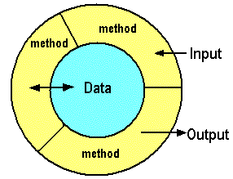
Encapsulation

Slide 54
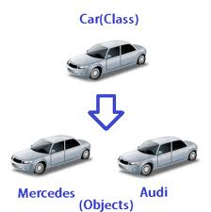
Abstraction

Slide 55
Inheritance
When you design with inheritance, you put common code in a class and then tell other more specific classes that the common (more abstract) class is their superclass.
When one class inherits from another, the subclass inherits from the superclass. Subclass extends the superclass.
Subclass can add new methods and instance variables of its own, and it can override the methods it inherits from the superclass. Instance variables are not overridden.
Notes:
When you design with inheritance, you put common code in a class and then tell other more specific classes that the common (more abstract) class is their superclass. When one class inherits from another, the subclass inherits from the superclass.
subclass extends the superclass.
An inheritance relationship means that the subclass inherits the members of the superclass. Subclass can add new methods and instance variables of its own, and it can override the methods it inherits from the superclass
Instance variables are not overridden.

Slide 56
Inheritance
inheritance: A way to form new classes based on existing classes, taking on their attributes/behavior.
a way to group related classes
a way to share code between two or more classes
We say that one class can extend another by absorbing its state and behavior.
superclass: The parent class that is being extended.
subclass: The child class that extends the superclass and inherits its behavior.
The subclass receives a copy of every field and method from its superclass.

Slide 57
Inheritance Syntax
Creating a subclass, general syntax:
public class <name> extends <superclass name> {
Example:
public class Secretary extends Employee {
....
}
By extending Employee, each Secretary object now:
receives a getHours, getSalary, getVacationDays, and getVacationForm method automatically
can be treated as an Employee by any other code (seen later) (e.g. a Secretary could be stored in a variable of type Employee or stored as an element of an Employee[])

Slide 58
Using IS-A and HAS-A
Surgeon IS-A Doctor.
"Bathroom HAS-A Tub“
If class B extends class A, class B IS-A class A. This is true anywhere in the inheritance tree. If class C extends class B, class C passes the IS-A test for both B and A.
Public members are inherited private members are Inherited.
Notes:
Surgeon IS-A Doctor.
"Bathroom HAS-A Tub“
If class B extends class A, class B IS-A class A. This is true anywhere in the inheritance tree. If class C extends class B, class C passes the IS-A test for both B and A.
Public members are inherited private members are Inherited.

Slide 59


Instance vs. Static Methods
Object Methods
public void add()
Instance Methods
Class Methods
public static void add()
Static Methods
Notes:
Static Methods – Class Methods
public static void add()
Instance Methods – Object Methods
public void add()

Slide 60
Polymorphism

Slide 61
Polymorphism
Polymorphism: The ability for the same code to be used with several different types of objects and behave differently depending on the type of object used.
A reference variable of a type T can legally refer to an object of any subclass of T.
Employee person = new Lawyer(3);
System.out.println(person.getSalary()); // 65000.0
System.out.println(person.getVacationForm()); // pink
You can call any methods from Employee on the variable person, but not any methods specific to Lawyer (such as sue).
Once a method is called on the object, it behaves in its normal way (as a Lawyer, not as a normal Employee).

Slide 62
Polymorphism + Parameters
You can declare methods to accept superclass types as parameters, then pass a parameter of any subtype.
public class EmployeeMain {
public static void main(String[] args) {
Lawyer lisa = new Lawyer(3);
Secretary steve = new Secretary(2);
printInfo(lisa);
printInfo(steve);
}
public static void printInfo(Employee empl) {
System.out.println("salary = " + empl.getSalary());
System.out.println("days = " + empl.getVacationDays());
System.out.println("form = " + empl.getVacationForm());
System.out.println();
}
}
OUTPUT:
salary = 65000.0
vacation days = 21
vacation form = pink
salary = 50000.0
vacation days = 10
vacation form = yellow

Slide 63
Polymorphism + Arrays
You can declare arrays of superclass types, and store objects of any subtype as elements.
public class EmployeeMain2 {
public static void main(String[] args) {
Employee[] employees = {new Lawyer(3), new Secretary(2),
new Marketer(4), new LegalSecretary(1)};
for (int i = 0; i < employees.length; i++) {
System.out.println("salary = " +
employees[i].getSalary());
System.out.println("vacation days = " +
employees[i].getVacationDays());
System.out.println();
}
}
}
OUTPUT:
salary = 65000.0
vacation days = 21
salary = 50000.0
vacation days = 10
salary = 60000.0
vacation days = 18
salary = 55000.0
vacation days = 10

Slide 64
Polymorphism – Two Types
Whenever same method name is exiting multiple times in the same class with different number or different types of parameters, it is known as Overloading Method.
Overloading
Whenever same method name is existing in both base class and derived class with same types of parameters, it is known as Overriding Method.
Overriding
Notes:
Two types:
Overloading: Whenever same method name is exiting multiple times in the same class with different number or different types of parameters is known asmethod overloading.
Overriding: Whenever same method name is existing in both base class and derived class with same types of parameters method Overriding

Slide 65
Overloading a Method
Method overloading is nothing more than having two methods with the same name but different argument lists.
You can't change ONLY the return type.
The return types can be different.
You can vary the access levels in any direction.
Notes:
Method overloading is nothing more than having two methods with the same name but different argument lists.
The return types can be different
You can't change ONLY the return type.
You can vary the access levels in any direction.

Slide 66
Overloading a Method
public class Overloads {
String uniqueID;
public int addNums (int a, int b) {
return a + b;
}
public double addNums(double a, double b) {
return a + b;
}

Slide 67
Overloading a Method
public void setUniqueID (String theID) {
II lots of validation code, and then:
uniqueID = theID;
}
public void setUniqueID (int ssNumber) {
String numString = "" + ssNumber;
setUniqueID (numString);
}
}

Slide 68
Why Overridden Methods?
Polymorphism is essential to object-oriented programming as it allows a general class to specify methods that will be common to all of its derivatives, while allowing subclasses to define the specific implementation of some or all of those methods.
Overridden methods allow Java to support run-time polymorphism.
Overridden methods are another way that Java implements the “one interface, multiple methods.”
Notes:
Overridden methods allow Java to support run-time polymorphism.
Polymorphism is essential to object-oriented programming as it allows a general class to specify methods that will be common to all of its derivatives,while allowing subclasses to define the specific implementation of some or all of those methods.
Overridden methods are another way that Java implements the “one interface, multiple methods”

Slide 69
Core Java
Notes:
Hello and welcome to this session on bonds trading.

Slide 70
Agenda
In this session, you will learn about:
Abstract Class
Interfaces
Static and Non Static Context
Final Class
Wrapper Class
Exception Class
Threads

Slide 71
Abstract Class

Slide 72
Abstract Class
An abstract class means that nobody can ever make a new instance of that class.
An abstract class has virtually:
NO USE
NO VALUE
NO PURPOSE IN LIFE, UNLESS IT IS EXTENDED
Notes:
An abstract class means that nobody can ever make a new instance of that class.
An abstract class has virtually* no use, no value, no purpose in life, unless it is extended.

Slide 73
Abstract Class
Besides classes, you can mark methods Abstract.
An abstract class means the class must be extended; an abstract method means the method must be overridden.
An abstract method has no body!
Public abstract void eat ()
No method body!
End it with a semicolon.
Notes:
Besides classes, you can mark methods Abstract.
An abstract class means the class must be extended; an abstract method means the method must be overridden.
An abstract method has no body!
public abstract void eat () ;
no method body!
End it with a semicolon.

Slide 74

Abstract Methods
If you declare an abstract method, you MUST mark the class abstract as well. You can’t have an abstract method in a non-abstract class.
NON-ABSTRACT CLASS
ABSTRACT
METHOD
If you put even a single abstract method in a class, you have to make the class abstract.
But you can mix both abstract and non-abstract methods in the abstract class.
Notes:
If you declare an abstract method, you MUST mark the class abstract as well. You can’t have an abstract method in a non-abstract class.
If you put even a single abstract method in a class, you have to make the class abstract.
But you can mix both abstract and non-abstract methods in the abstract class.

Slide 75
Interface

Slide 76
Interface
A Java interface solves your multiple inheritance problem by giving you much of the polymorphic benefits of multiple inheritance. A Java interface is like a 100% pure abstract class.
Example:
Public interface pet { . . . }
Use the keyword “interface”
Instead of “class”
Public class dog implements pet { . . . }
Use the keyword “implements” followed by the interface name.
Note that when you implement an interface you still get to extend a class.
Notes:
A Java interface solves your multiple inheritance problem by giving you much of the polymorphic benefits of multiple inheritance.
A Java interface is like a 100% pure abstract class
example:- 1) public interface pet { . . . }
use the keyword “interface”
instead of “class”
2) public class dog implements pet { . . . }
Use the keyword “implements” followed by the interface name. Note that
when you implement an interface you
still get to extend a class

Slide 77
Interface
Making and Implementing the Pet interface:
You say ‘interface’ instead of
‘class’ here
public interface pet { All interface methods are
abstract, so they Must end
public abstract void beFriendly () ; in semicolons. Remember,
they have no body!
public abstract void play () ;
}
Notes:
Making and Implementing the Pet interface
You say ‘interface’ instead of
‘class’ here
public interface pet { All interface methos are
abstract, so they Must end
public abstract void beFriendly () ; in semicolons. Remember,
they have no body!
public abstract void play () ;
}

Slide 78
Example
interface A
{
public void add();
}
class B implements A
{
public void add()
{
System.out.println("Hello");
}
public void sub()
{
System.out.println("Hi");
}
}
public class MyInterface
{
public static void main(String a[])
{
A obj = new B();
obj.add();
obj.sub();
}

Slide 79
Regular (Non-static) vs. Static Methods

Slide 80
Regular (Non-static) vs. Static Methods
Java is object-oriented, but once in a while you have a special case, typically a utility method (like the Math methods), where there is no need to have an instance of the class.
The keyword static lets a method run without any instance of the class.
A static method means "behavior not dependent on an instance variable, so no instance/object is required. Just the class."
Notes:
Java is object-oriented, but once in a while you have a special case, typically a utility method (like the Math methods), where there is no need to have an instance of the class.
The keyword static lets a method run without any instance o/the class.
A static method means "behavior not dependent on an instance variable, so no instance/object is required. Just the class."

Slide 81
Regular (Non-static) vs. Static Methods
Call a static method using a class name
Math. Min (88, 86)
Math
Min() Max() Abs() ….
Call a non-static method using a reference variable name
Song t2 = new Song () ;
t2. play () ;

Slide 82
Regular (Non-static) vs. Static Methods
Static Methods can‘t use non-static (instance) variables!
public class Duck {
private lnt size;
public static void main (String[] arqs) {
System.out.println("Size of duck is " + size):
}
public void setsize (int s) {
size = s;
}
public int getSize()
return size;
}
}

Slide 83
Regular (Non-static) vs. Static Methods
Static methods can’t use non-static methods, either!
public class Duck {
private int size;
public static void main (String [ ] args) {
System.out.println(“Size is “ + getsize () ) ;
}
public void setsize(int s) {
size = S;
}
public int getsize () {
return size;
}
}

Slide 84
Static Variable

Slide 85
Static Variable
Static variable: Value is the same for ALL instances of the class
Static variables are shared.
All instances of the same class share a single copy of the static variables.
All static variables in a class are Initialized before any object of that class can be created.

Slide 86
Static Final Variables
Static final variables are constants.
public static final double PI = 3.141592653589793;
Constant variable names should be in all caps!

Slide 87
Final

Slide 88
Final
Final isn’t just for static variables.
Non-static final variables
Final method
Final class
A final variable means you can't change its value.
A final method means you can't override the method.
A final class means you can't extend the class (i.e. you can't make a subclass).

Slide 89
Wrapping a Primitive

Slide 90
Wrapping a Primitive
Boolean
Character
Byte
Short
Integer
Long
Float
Double

Slide 91
Wrapping a Primitive
Wrapping a value
int i = 288;
Integer wrap = new Integer (i) ;
Unwrapping a values

Slide 92
Exception

Slide 93
Exception
Exceptions are a run-time mechanism for indicating exceptional conditions in Java
If you detect an "exceptional" condition, you can throw an exception
An exception is an object that contains relevant error info
Somewhere up the call stack, the exception is caught and dealt with
If the exception is not caught, your application terminates

Slide 94
Categories of Exceptions in Java
There are lots of things that can go wrong in a Java app
Therefore, there are lots of different exception classes
Each exception class represents a different kind of problem
The Java library defines hundreds of standard exception classes (see later for some examples)
Java classifies exceptions into 3 categories:
Throwable
Error
Exception
RuntimeException
Checked exception classes
You MUST catch these,
Unchecked exception classes
or you'll get a compiler error.
You CAN catch these, but prevention is better

Slide 95
Exception
try {
// do risky thing
} catch (Exception ex) {
// try to recover
}
Exceptions that are NOT subclasses of RuntimeException are checked for by the compiler.
These are called as “Checked Exception.”
The compiler checks for everything except RuntimeException.

Slide 96
Exception
Runtime Exception are NOT checked by the compiler. They’re known as (big surprise here) “Unchecked Exception”.
You can throw, catch and declare Runtime Exceptions, but you don’t have to and the compiler won’t check.
A method can throw multiple exceptions.
But a method’s declaration must declare all the checked exceptions it can throw.

Slide 97
Exceptions are Polymorphic
Exception are objects.
Exception can be referred to polymorphically.
The benefit for exception is that a method doesn’t have to explicitly declare every possible exceptions it might throw.
You can DECLARE exceptions using a super type of the exception you throw.
You can CATCH exception using a super type of the exception thrown.
Multiple catch blocks must be ordered from smallest to biggest.

Slide 98
Nested Try Statements
The try statement can be nested.
That is, a try statement can be inside the block of another try.
Each time a try statement is entered, the context of that exception is pushed on the stack.
If an inner try statement does not have a catch handler for a particular exception, the stack is unwound and the next try statement’s catch handlers are inspected for a match.

Slide 99
Throws
If a method is capable of causing an exception that it does not handle, it must specify this behavior so that callers of the method can guard themselves against that exception.
You do this by including a throws clause in the method’s declaration.
A throws clause lists the types of exceptions that a method might throw.

Slide 100
Finally
When exceptions are thrown, execution in a method takes a rather abrupt, non-linear path that alters the normal flow through the method.
Depending upon how the method is coded, it is even possible for an exception to cause the method to return prematurely.
This could be a problem in some methods.
Example, if a method opens a file upon entry and closes it upon exit, then you will not want the code that closes the file to be bypassed by the exception-handling mechanism.
The finally keyword is designed to address this contingency..

Slide 101

Exception Classes
Standard Exception Classes
Defining Custom Exception Classes
Throwing Exceptions

Slide 102
Standard Exception Classes (1 of 2)
Java SE defines hundreds of standard exception classes
Located in relevant packages (e.g. java.io, java.sql, etc)
Here are some of the standard exception classes
Exception class | Description | Typically thrown…
ArrayIndexOutOfBoundsException | Attempt to access beyond the end (or start) of an array | By JVM
ClassCastException | Attempt to cast a reference variable to an incompatible type | By JVM
IllegalArgumentException | An illegal argument has been passed into a method | Programmatically
IllegalStateException | Attempt to use an object incorrectly in its given state | Programmatically
NullPointerException | Attempt to use a null reference variable | By JVM
NumberFormatException | Formatting error when trying to convert a numeric string into a number | Programmatically
AssertionError | Assertion error (see next section) | Programmatically

Slide 103
Standard Exception Classes (2 of 2)
Here are some more standard exception classes
Exception class | Description | Typically thrown…
ExceptionInInitializerError | Error when attempting to initialize a static variable, or in an init block. | By JVM
StackOverflowError | Stack overflow (typically caused by a rampant recursive method) | By JVM
NoClassDefFoundError | JVM can't find a class it needs (e.g. due to command-line error, or classpath problem) | By JVM

Slide 104

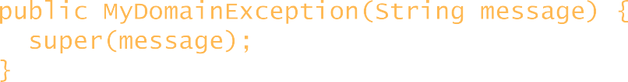
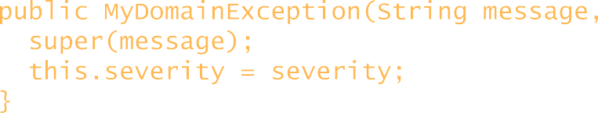
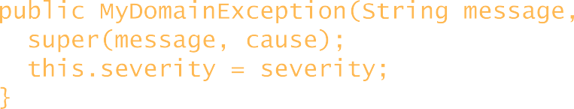
Defining Custom Exception Classes
You can define your own domain-specific exception classes
Define a class that extends Exception
Define a string constructor, plus other constructors/methods
public class MyDomainException extends Exception {
private Date timestamp = new Date(); int severity = 0;
public MyDomainException(String super(message);
}
message) {
public MyDomainException(String super(message);
this.severity = severity;
}
message,
int severity) {
public MyDomainException(String super(message, cause); this.severity = severity;
}
message,
Throwable cause,
int severity) {
// Getters for timestamp and severity …
}

Slide 105
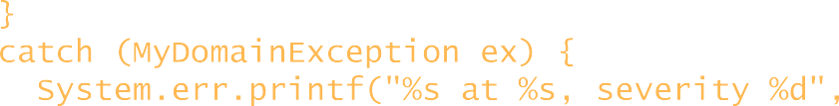
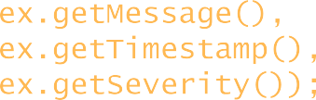
Throwing Exceptions
To throw an exception:
Use the throw keyword
Specify an exception object (typically a newly-created one)
Example:
public static void demoCustomExceptions() {
try {
System.out.println("Hello from demoCustomExceptions()"); throw new MyDomainException("It's gone pear-shaped", 5);
}
catch (MyDomainException ex) {
System.err.printf("%s at %s, severity %d", ex.getMessage(),
ex.getTimestamp(), ex.getSeverity());
}
}

Slide 106
The java.io.File Class

Slide 107
The java.io.File Class
The java.io.File class represents a file on disk.
A file object represents the name and path of a file or directory on Disk, Example: /Users/Reddy/Data/GameFile.txt
Some thing you can do with a File object:
Make a file object representing an existing file
File f = new File (“MyCode.txt”);
Make a new directory
File dir = new File (“Demo”);
Dir.mkdir();

Slide 108
Example
import java.io.DataInputStream;
import java.io.DataOutputStream;
import java.io.File;
import java.io.FileInputStream;
import java.io.FileOutputStream;
public class FileDemo
{
public static void main(String[] args) throws Exception
{

Slide 109
Example
File f = new File("demo.txt");
FileOutputStream fos = new FileOutputStream(f);
DataOutputStream dos = new DataOutputStream(fos);
dos.writeUTF("Navin");
FileInputStream fis = new FileInputStream(f);
DataInputStream dis = new DataInputStream(fis);
String str = dis.readUTF();
System.out.println(str);
}
}

Slide 110
Example
List the contents of a directory
if (dir.isDirectory() ) {
string[ ] dirContents = dir.list () ;
for (int I = 0; I < dirContents.length; i++) {
System.out.println(dirContents[i]) ;
}
}
Get the absolute path of a file or directory
System.out.println(dir.getAbsolutePath() ) ;
Delete a file or directory (returns true if successful)
boolean isDeleted = f.delete () :

Slide 111
Saving Objects
Object have sate and behavior.
Behavior lives in the class, but sate lives within each individual object.
If your data will be used by only the Java program that generated it:
Use serialisation
Write a plain text file

Slide 112
Writing a Serialized Object to a File
Make a FileOutputstream
FileOutputStream fileStream = new FileOutputStream (“MYGame.ser”);
Make an ObjectOutputStream
ObjectOutputStream os = new ObjectOutputStream(fileStream);
Write the object
os.writeObject(characterOne);
os.writeObject(characterTwo);
os.writeObject(characterThree);
Close the ObjectOutputStream
Os.close();

Slide 113
Implementing Serializable
If You Want Your Class To Be Serializable,
Implement Serializable
The Serializable interface is know as a marker tag interface.
Its sole purpose is to announce that the class implementing it is, well, serializable.
objectOutputstream.writeObject(myBox);
Whatever goes here Must implement
Serializable or it will fail at runtime.

Slide 114
Example
import java.io.*;
public class SerializationDemo
{
public static void main(String args[])
{
NewString ino, outo;
ino = new NewString("");
outo = new NewString("Hello from Java!");
try
{
FileOutputStream fos = new FileOutputStream("serialized.txt");
ObjectOutputStream oos = new ObjectOutputStream(fos);
oos.writeObject(outo);
oos.flush();
oos.close();

Slide 115
Example
FileInputStream fis = new FileInputStream("serialized.dat");
ObjectInputStream ois = new ObjectInputStream(fis);
ino = (NewString)ois.readObject();
ois.close();
}
catch(Exception e) {}
System.out.println(ino);
}
}
class NewString implements Serializable
{
String data;
public NewString(String instring)
{
data = instring;
}
public String toString()
{
return data;
}
}

Slide 116
Thread Class

Slide 117
Thread Class
A thread is separate ‘Thread of Execution’.
In other words, a separate call stack.
A Thread is a Java class that represents a thread.
To make a thread, make a Thread.

Slide 118
Thread Class
The JVM calls the main() method.
public static void main (string[ ] args) {
. . .
}
Main () starts a new thread. He main thread is temporarily frozen while the new thread starts running.
The JVM switches between the new thread (user thread A) and the original main thread, until both threads complete.

Slide 119
Example
import java.util.logging.Level;
import java.util.logging.Logger;
public class BasicThread
{
public static void main(String[] args) {
A a = new A();
B b = new B();
Thread ta = new Thread(a);
Thread tb = new Thread(b);
ta.start();
tb.start();
}
}

Slide 120
Example
class A implements Runnable
{
public void run()
{
showHello();
}
public void showHello()
{
for(int i=1;i<=10;i++)
{
try {
System.out.println("Hello " + i);
Thread.sleep(100);
} catch (Exception ex) {
Logger.getLogger(A.class.getName()).log(Level.SEVERE, null, ex);
}
}
}
}

Slide 121
Example
class B implements Runnable
{
public void run()
{
showHi();
}
public void showHi()
{
for(int i=1;i<=10;i++)
{
try {
System.out.println("Hi " + i);
Thread.sleep(100);
} catch (Exception ex) {
ex.printStackTrace();
}
}
}
}

Slide 122
Thread Priorities
Java assigns to each thread a priority that determines how that thread should be treated with respect to the others.
Thread priorities are integers that specify the relative priority of one thread to another.
As an absolute value, a priority is meaningless; a higher-priority thread doesn’t run any faster than a lower-priority thread if it is the only thread running.
Instead, a thread’s priority is used to decide when to switch from one running thread to the next.
This is called a context switch.

Slide 123
Creating a Thread
In the most general sense, you create a thread by instantiating an object of type Thread.
Java defines two ways in which this can be accomplished:
You can implement the Runnable interface.
You can extend the Thread class, itself.

Slide 124
Thread Synchronization
When we start two or more threads within a program, there may be a situation when multiple threads try to access the same resource and finally they can produce unforeseen result due to concurrency issue.
Example: If multiple threads try to write within a same file then they may corrupt the data because one of the threads can overwrite data or while one thread is opening the same file at the same time another thread might be closing the same file.

Slide 125
Thread Synchronization
synchronized(objectidentifier)
{
// Access shared variables and other shared resources
}
The objectidentifier is a reference to an object whose lock associates with the monitor that the synchronized statement represents.

Slide 126
Thread Synchronization
import java.util.logging.Level;
import java.util.logging.Logger;
public class SyncDemo
{
int count = 0;
public static void main(String[] args)
{
SyncDemo obj = new SyncDemo();
obj.show();
}
public synchronized void increment()
{
count++;
}

Slide 127
Thread Synchronization
public void show()
{
try {
Thread t1 = new Thread(new Runnable()
{
public void run()
{
for(int i=1;i<=10000;i++)
{
increment();
}
}
});
Thread t2 = new Thread(new Runnable()
{
public void run()
{
for(int i=1;i<=10000;i++)
{
increment();
}
}
});

Slide 128
Thread Synchronization
t1.start();
t2.start();
t1.join();
t2.join();
System.out.println("count is " + count);
} catch (InterruptedException ex) {
Logger.getLogger(SyncDemo.class.getName()).log(Level.SEVERE, null, ex);
}
}
}

Slide 129
Example
Thread (Join and IsAlive)
Thread Join() – It tells the Thread Scheduler that the thread on which the join method has been invoked should execute first and then after execution it should allow the rest of the threads to run. Here Thread t3 ensures that it will complte first before any other thread.
Thread isAlive() – It returns a Boolean value only to inform that whether the current thread is alive or dead.

Slide 130
Example
public class MyJoin {
public static void main(String[] args) {
// TODO Auto-generated method stub
System.out.println("Starting Point is:- " + Thread.currentThread().getName());
Thread t1 = new Thread(new MyThreadRunnable(), "MyRunnableThread1");
Thread t2 = new Thread(new MyThreadRunnable(), "MyRunnableThread2");
Thread t3 = new Thread(new MyThreadRunnable(), "MyRunnableThread3");
try {
t3.start();
t3.join(5000);
System.out.println("Is Thread3 alive Now? " + t3.isAlive());
t2.start();
t2.join();
System.out.println("Is Thread2 alive Now? " + t2.isAlive());
t1.start();
t1.join();
System.out.println("Is Thread1 alive Now? " + t1.isAlive());
System.out.println("Is main Thread? " + Thread.currentThread().getName());
System.out.println("Is alive? " + Thread.currentThread().isAlive());
} catch (InterruptedException e) {
e.printStackTrace();
}
}
}

Slide 131
Core Java - Day 3
Notes:
Hello and welcome to this session on bonds trading.

Slide 132
Agenda
In this session, you will learn about:
Collection Framework
Accessing Database with JDBC
JDK 1.8 Introduction

Slide 133
Java Collection Framework Hierarchy

Slide 134
Common Collection Classes / Interfaces
<<interface>> Collection
<<interface>> Map
<<interface>> Set
<<interface>>
List
HashMap
TreeMap
HashSet
ArrayList
LinkedList

Slide 135
Understanding the Classes / Interfaces
Collection
Base interface for Set and List interfaces
Set
Set-based collections guarantee element uniqueness
E.g. HashSet uses hash codes to ensure element uniqueness
List
List-based collections store elements sequentially, by position
E.g. ArrayList stores elements internally as an array
E.g. LinkedList stores elements internally as a linked list
Map
Map-based collections store key/value pairs
E.g. HashMap arranges items by using hash codes
E.g. TreeMap arranges items in a tree

Slide 136
Collection Interfaces
The Collection interface is the foundation upon which the collections framework is built.
It declares the core methods that all collections will have.
Objects are added to a collection by calling add( ).
Notice that add( ) takes an argument of type Object.
Because Object is a superclass of all classes, any type of object may be stored in a collection.

Slide 137
The Set Interface
The Set interface extends the Collection interface.
It does not introduce new methods or constants, but it stipulates that an instance of Set contains no duplicate elements.
The concrete classes that implement Set must ensure that no duplicate elements can be added to the set.
That is no two elements e1 and e2 can be in the set such that e1.equals(e2) is true.

Slide 138
The Abstract Set Class
The Abstract Set class is a convenience class that extends Abstract Collection and implements Set.
The Abstract Set class provides concrete implementations for the equals method and the hash Code method.
The hash code of a set is the sum of the hash code of all the elements in the set.
Since the size method and iterator method are not implemented in the Abstract Set class, Abstract Set is an abstract class.

Slide 139
The HashSet Class
The HashSet class is a concrete class that implements Set.
It can be used to store duplicate-free elements.
For efficiency, objects added to a hash set need to implement the hashCode method in a manner that properly disperses the hash code.

Slide 140
The Sorted Set Interface & the Tree Set Class
Sorted Set is a sub-interface of Set, which guarantees that the elements in the set are sorted.
Tree Set is a concrete class that implements the Sorted Set interface.
You can use an iterator to traverse the elements in the sorted order.

Slide 141
The Comparator Interface
Sometimes you want to insert elements of different types into a tree set.
The elements may not be instances of Comparable or are not comparable.
You can define a comparator to compare these elements.
To do so, create a class that implements the java.util.Comparator interface.
The Comparator interface has two methods, compare and equals.

Slide 142
The List Interface
A set stores non-duplicate elements.
To allow duplicate elements to be stored in a collection, you need to use a list.
A list can not only store duplicate elements, but can also allow the user to specify where the element is stored.
The user can access the element by index.

Slide 143
Array List

Slide 144
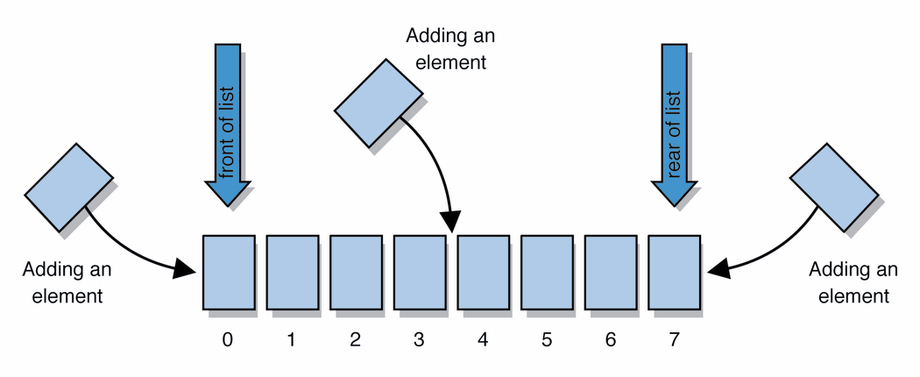
Agenda
list: an ordered sequence of elements, each accessible by a 0-based index
one of the most basic collections of data

Slide 145
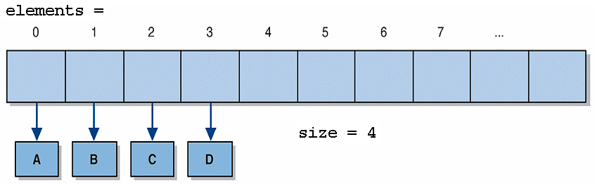
Agenda
Class ArrayList<E> implements the notion of a list using a partially-filled array
when you want to use ArrayList, remember to import java.util.*;

Slide 146
ArrayList Features
think of it as an auto-resizing array that can hold any type of object, with many convenient methods
maintains most of the benefits of arrays, such as fast random access
frees us from some tedious operations on arrays, such as sliding elements and resizing
can call toString on an ArrayList to print its elements
[1, 2.65, Marty Stepp, Hello]

Slide 147
Generic Classes
generic class: A type in Java that is written to accept another type as part of itself.
Generic ("parameterized") classes were added to Java to improve the type safety of Java's collections.
A parameterized type has one or more other types' names written between < and > .
ArrayList<E> is a generic class.
The <E> is a placeholder in which you write the type of elements you want to store in the ArrayList.
Example:
ArrayList<String> words = new ArrayList<String>();
Now the methods of words will manipulate and return Strings.

Slide 148
ArrayList vs. Array
array
String[] names = new String[5];
names[0] = "Jennifer";
String name = names[0];
ArrayList
ArrayList<String> namesList = new ArrayList<String>();
namesList.add("Jennifer");
String name = namesList.get(0);

Slide 149
Adding Elements
Elements are added dynamically to the list:
ArrayList<String> list = new ArrayList<String>();
System.out.println("list = " + list);
list.add("Tool");
System.out.println("list = " + list);
list.add("Phish");
System.out.println("list = " + list);
list.add("Pink Floyd");
System.out.println("list = " + list);
Output:
list = []
list = [Tool]
list = [Tool, Phish]
list = [Tool, Phish, Pink Floyd]

Slide 150
Removing Elements
Elements can also be removed by index:
System.out.println("before remove list = " + list);
list.remove(0);
list.remove(1);
System.out.println("after remove list = " + list);
Output:
before remove list = [Tool, U2, Phish, Pink Floyd]
after remove list = [U2, Pink Floyd]
Notice that as each element is removed, the others shift downward in position to fill the hole.
Therefore, the second remove gets rid of Phish, not U2.
index | 0 | 1 | 2 | 3
value | Tool | U2 | Phish | Pink Floyd
index | 0 | 1 | 2
value | U2 | Phish | Pink Floyd
index | 0 | 1
value | U2 | Pink Floyd

Slide 151
ArrayList Methods
Method name | Description
add(value) | adds the given value to the end of the list
add(index, value) | inserts the given value before the given index
clear() | removes all elements
contains(value) | returns true if the given element is in the list
get(index) | returns the value at the given index
indexOf(value) | returns the first index at which the given element appears in the list (or -1 if not found)
lastIndexOf(value) | returns the last index at which the given element appears in the list (or -1 if not found)
remove(index) | removes value at given index, sliding others back
size() | returns the number of elements in the list

Slide 152
Java Collection Framework Hierarchy
A collection is a container object that represents a group of objects, often referred to as elements.
The Java Collections Framework supports three types of collections, named sets, lists, and maps.

Slide 153
Collections vs. Arrays
A collection is an object that holds a group of other objects
Some collection types (e.g. ArrayList) actually use arrays internally to store the data
Differences between arrays and collections:
Arrays are a Java language feature
Collections are standard Java classes, in the java.util package
Arrays are pretty basic
Collections provide lots of useful methods to manipulate contents
Arrays are fixed size
Collections are resizable
Arrays can store primitive types as well as objects
Collections store only objects
Arrays are processed using indexes
Collections are usually processed without using indexes

Slide 154
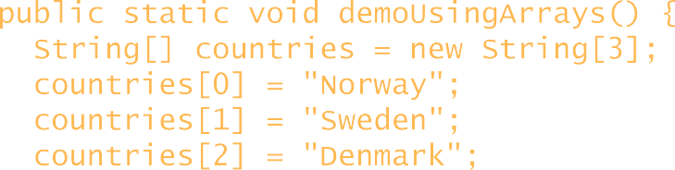
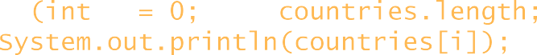
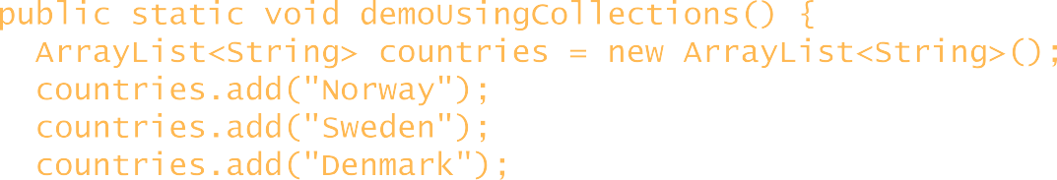
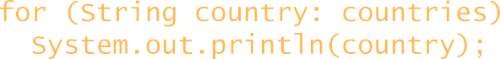
Simple Code Examples
This code uses arrays:
public static void demoUsingArrays() { String[] countries = new String[3];
countries[0] countries[1] countries[2]
= "Norway";
= "Sweden";
= "Denmark";
for (int i = 0; i < countries.length; i++)) System.out.println(countries[i]);
}
Equivalent code, using collections:
See next section for discussion of <> generics syntax
import java.util.*;
…
public static void demoUsingCollections() { ArrayList<String> countries = new ArrayList<String>(); countries.add("Norway");
countries.add("Sweden"); countries.add("Denmark");
for (String country: countries) System.out.println(country);
Collectionsvs.Arrays.java

Slide 155
The List Interface
import java.util.*;
public class DemoCollection
{
public static void main(String a[])
{
ArrayList<String> names=new ArrayList<String>();
names.add("Navin");
names.add("Rizwan");
names.add("Nikita");
for(String s : names)
{
System.out.println(s);
}
}
}

Slide 156
The Collections Class
The Collections class contains various static methods for operating on collections and maps, for creating synchronized collection classes, and for creating read-only collection classes.

Slide 157
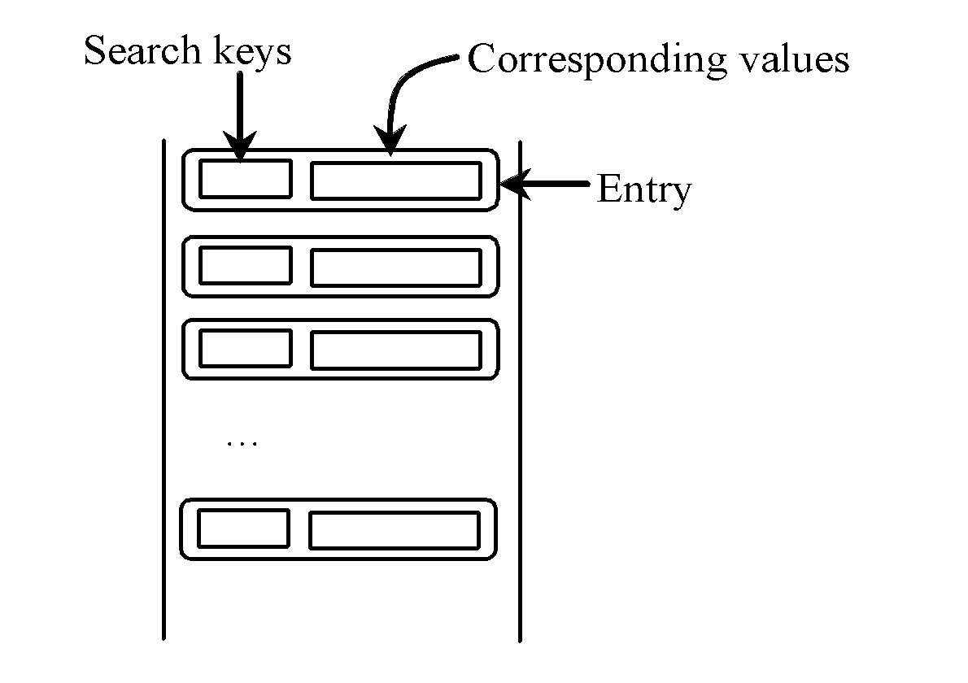
The Map Interface
The Map interface maps keys to the elements. The keys are like indexes.
In List, the indexes are integer. In Map, the keys can be any objects.

Slide 158
HashMap and TreeMap
The HashMap and TreeMap classes are two concrete implementations of the Map interface.
The HashMap class is efficient for locating a value, inserting a mapping, and deleting a mapping.
The TreeMap class, implementing SortedMap, is efficient for traversing the keys in a sorted order.

Slide 159
Comparators

Slide 160
Comparators
Both TreeSet and TreeMap store elements in sorted order. However, it is the comparator that defines precisely what “sorted order” means.
By default, these classes store their elements by using what Java refers to as “natural ordering,” which is usually the ordering that you would expect.
If you want to order elements a different way, then specify a Comparator object when you construct the set or map.
Doing so gives you the ability to govern precisely how elements are stored within sorted collections and maps.
The Comparator interface defines two methods: compare( ) and equals( ).
The compare( ) method, shown here, compares two elements for order: int compare(Object obj1, Object obj2)

Slide 161
Comparator (1 of 2)
Suppose you want something different from the natural ordering
For example, you might want to sort employees by name
But the natural ordering is fixed
Java provides another way to order objects: a comparator
A comparator is something that compares two values by implementing the interface java.util.Comparator:
public interface Comparator<T> { public int compare(T a, T b);
}
The definition of compare is very like compare To:
If a is less than b, compare returns a negative number
If a is equal to b, compare returns zero
If a is greater than b, compare returns a positive number

Slide 162
Comparator (2 of 2)
Here’s how we could sort employees by name:
public class Employee implements Comparable<Employee> {
...
}
class EmployeeNameComparator implements Comparator<Employee> {
public int
String String return
}
compare(Employee emp1, Employee emp2) { name1 = emp1.getName();
name2 = emp2.getName();
name1.compareTo(name2);
// use the natural ordering
// on String
}
An overload of min accepts a Comparator:
public static <T> T min(List<T> list, Comparator<T> compr)
We could call it like this:
Employee firstEmployeeByName = min(employeeList, new EmployeeNameComparator());
Every library method for comparing values (sorting, finding max/min, etc) has two overloads, one that uses natural ordering and one that accepts a comparator

Slide 163
Comparator in Java 8
Until Java 8, interfaces had only abstract methods
From Java 8, interfaces can also have default (i.e. instance ) methods, and static methods
For example, new methods were added to the interface Comparator in Java 8, including
Default methods, e.g. reversed()
// reversed returns a comparator that imposes the reverse ordering
// to this comparator
public default Comparator<T> reversed() {...}
And static methods, e.g. nullsFirst()
// takes a comparator and creates a new one with the same ordering, except that the
// new one accepts null values, considering them to be less than all non-null values
static Comparator<T> nullsFirst(Comparator<T> comp) { ... }

Slide 164
Accessing Databases using JDBC

Slide 165
JDBC Drivers and Connections
What is JDBC?
JDBC Classes and Interfaces
JDBC Architecture
Using the Derby Database
Loading JDBC Drivers
Connecting to a Database

Slide 166



What is JDBC?
Scalability, security, and access control
Ease of maintenance and deployment
Centralized business rules
Java client app or HTML form
Java server app
RMI, CORBA,
JDBC
Web Service, or HTTP
Database
Client machine
Network
Web server or App server
Network

Slide 167
JDBC Classes and Interfaces
JDBC is a set of standard Java classes and interfaces
Defined in the java.sql package
import java.sql.*;
The JDBC interfaces specify a standard programming model, to access any RDBMS
<<interface>> Connection
<<interface>> Statement
Create a Statement object, and execute it to fire off SQL against the database
<<interface>> ResultSet
When you execute a SQL SELECT statement, the results are returned in a ResultSet object

Slide 168



JDBC Architecture
Each database vendor provides its own driver(s), to access a particular RDBMS
For example, there are JDBC drivers for Oracle, Sybase, DB2, etc.
Each driver implements the aforementioned Java interfaces, to provide access to a particular RDBMS product
The java.sql package defines a class named DriverManager, to coordinate JDBC drivers
Use DriverManager to load a driver, and connect to a database
Your Java application
JDBC Driver Manager
Oracle JDBC driver
Sybase JDBC driver
Derby JDBC driver
JDBC/ODBC bridge driver
ODBC driver
Sybase
Derby
e.g. MS Access

Slide 169
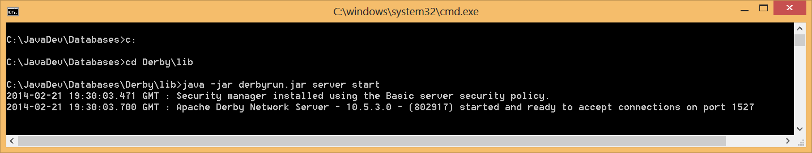
Using the Derby Database
An open-source, free, pure Java Database Management System
Downloadable from http://db.apache.org/derby
See C:\JavaDev\Databases\Derby
Contains Derby JARS and runtime engine
Run C:\JavaDev\Databases\StartDerby.bat

Slide 170
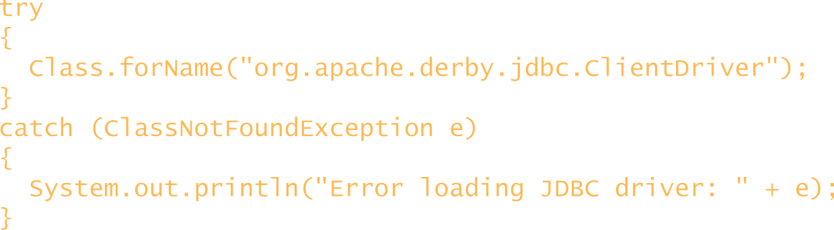
Load JDBC Drivers
Each JDBC driver is a Java class
You must load this class into the JVM first, before you can connect to the database or execute any SQL statements
For example, the following code loads the Derby client driver class
When the driver is loaded, it automatically registers itself with the JDBC Driver Manager
try
{
Class.forName("org.apache.derby.jdbc.ClientDriver");
}
catch (ClassNotFoundException e)
{
System.out.println("Error loading JDBC driver: " + e);
}

Slide 171
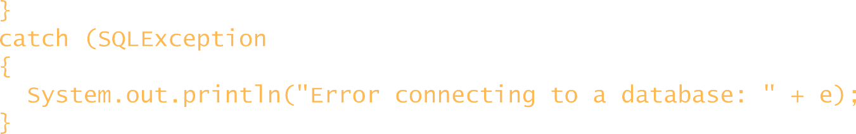
Connecting to a Database
Once you have loaded the JDBC driver, you can use
DriverManager to open a connection to a database
Call DriverManager.getConnection()
JDBC uses URI syntax to denote database names
The URI syntax is "jdbc:<protocol>:DatabaseName"
For example, the following code connects to the Derby sample database for this course
Connection cnEmps = null; try
{
cnEmps = DriverManager.getConnection( "jdbc:derby://localhost:1527/C:/JavaDev/Databases/MyDatabase");
}
catch (SQLException e)
{
System.out.println("Error connecting to a database: " + e);
}

Slide 172
Statements and Results
Representing SQL statements in JDBC
Executing a SELECT statement
Processing query results
Mapping SQL types to Java types
Executing INSERT, DELETE, and UPDATE statements
Using prepared statements
Using stored procedures
Handling output parameters and return values from a stored procedure
Using transactions

Slide 173
Representing SQL statements in JDBC
JDBC defines three separate interfaces, to enable you to execute SQL statements in various ways
<<interface>> Statement
<<interface>> PreparedStatement
Use a PreparedStatement to execute prepared (precompiled) SQL statements.
<<interface>> CallableStatement
Use a CallableStatement to execute stored procedures. Some databases (e.g. Oracle) allow you to write stored procedures in Java.

Slide 174
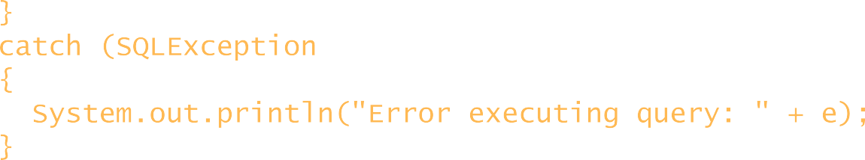
Executing a SELECT Statement
You can use a Statement object to execute a SQL SELECT statement
This is the simplest and most common task in many Java apps
ResultSet rsEmps = null; try
{
Statement st = cnEmps.createStatement();
rsEmps = st.executeQuery("SELECT Name, Salary FROM MySchema.Employees");
}
catch (SQLException e)
{
System.out.println("Error executing query: " + e);
}
executeQuery() returns a ResultSet object
The ResultSet object holds the selected rows and columns

Slide 175


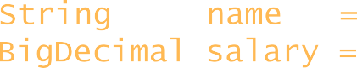

Processing Query Results
ResultSet gives cursor-like access to the selected rows
JDBC 1.0 supports forward-only cursors
JDBC 2.0 adds support for backwards cursors
ResultSet has a suite of methods named getXxxx(), to get a column's value as a specific data type
Access columns by name, or by column number (starting at 1!)
ResultSet rsEmps =
st.executeQuery("SELECT Name, Salary FROM MySchema.Employees");
while (rsEmps.next() != false)
{
String name = BigDecimal salary =
// String name
rsEmps.getString(1); rsEmps.getBigDecimal(2);
= rsEmps.getString("Name");
// BigDecimal salary = rsEmps.getBigDecimal("Salary");
}

Slide 176
Mapping SQL Types to Java Types
SQL type | Java type
CHAR, VARCHAR, LONGVARCHAR | java.lang.String
TINYINT | byte
SMALLINT | short
INTEGER | int
BIGINT | long
REAL | float
FLOAT, DOUBLE | double
BINARY, VARBINARY, LONGVARBINARY | byte[]
NUMERIC, DECIMAL | java.math.BigDecimal
BIT | boolean
TIME | java.sql.Time java.sql.Timestamp
TIMESTAMP
DATE | java.sql.Date
14

Slide 177
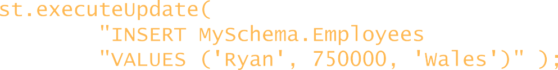
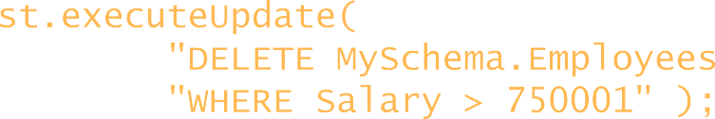
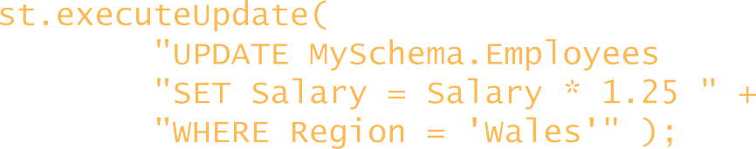
INSERT, DELETE, UPDATE
You can use a Statement object to execute a SQL INSERT, DELETE, or UPDATE statement
You can also execute DDL statements (such as CREATE TABLE) and DCL statements (such as GRANT PERMISSION)
int rowsAffected
= st.executeUpdate(
"INSERT MySchema.Employees " + "VALUES ('Ryan', 750000, 'Wales')" );
int rowsAffected
= st.executeUpdate(
"DELETE MySchema.Employees " + "WHERE Salary > 750001" );
DELETE
example
int rowsAffected
= st.executeUpdate(
"UPDATE MySchema.Employees " + "SET Salary = Salary * 1.25 " + "WHERE Region = 'Wales'" );
UPDATE
example

Slide 178
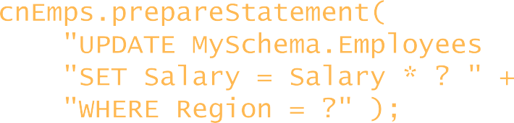
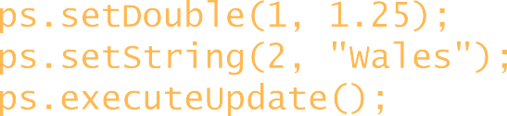
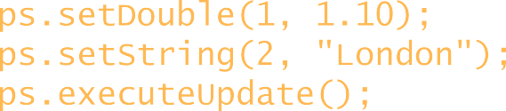
Using Prepared Statements
A prepared statement is a statement whose SQL is only compiled the first time it is executed
Useful for optimization purposes, if you need to execute the same SQL statement several times with different parameters
Create a PreparedStatement in Java
Supply parameters each time you execute the statement
PreparedStatement ps = cnEmps.prepareStatement(
"UPDATE MySchema.Employees " + "SET Salary = Salary * ? " + "WHERE Region = ?" );
ps.setDouble(1, 1.25); ps.setString(2, "Wales"); ps.executeUpdate();
ps.setDouble(1, 1.10); ps.setString(2, "London"); ps.executeUpdate();

Slide 179
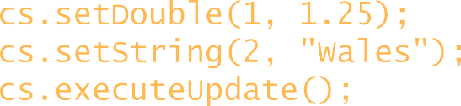

Using Stored Procedures
Many enterprise Java apps use stored procedures to encapsulate SQL statements
Performance, security, access control, centralized business rules
Create a CallableStatement in Java
Supply parameters if necessary
CallableStatement cs = cnEmps.prepareCall(
"{ call updateSalaries(?,?)
}" );
cs.setDouble(1, 1.25); cs.setString(2, "Wales"); cs.executeUpdate();
CREATE PROCEDURE updateSalaries(@rate DOUBLE, @reg VARCHAR) AS
UPDATE MySchema.Employees SET Salary = Salary * @rate WHERE Region = @reg

Slide 180
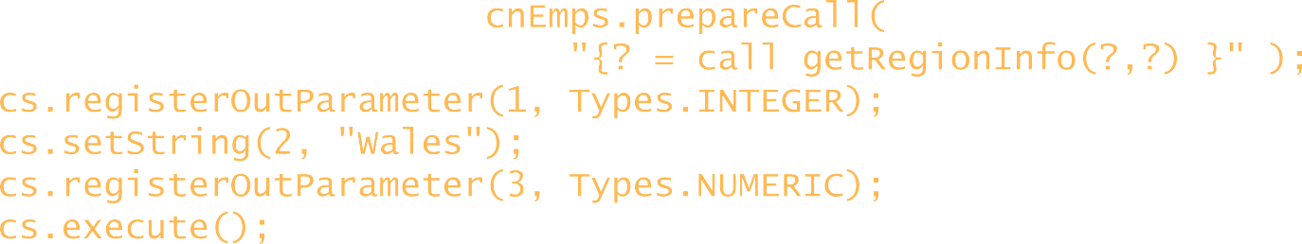


Handling Output Parameters and Results
A stored procedure can assign output parameters, and can also return a result value
You must register these output params/result in your Java call
CallableStatement cs = cnEmps.prepareCall(
"{? = call getRegionInfo(?,?) }" );
cs.registerOutParameter(1, cs.setString(2, "Wales"); cs.registerOutParameter(3, cs.execute();
Types.INTEGER);
Types.NUMERIC);
System.out.println("Number of emps in Wales: " + cs.getInt(1)); System.out.println("Average salary is £" + cs.getBigDecimal(3));
CREATE PROCEDURE getRegionInfo(@reg VARCHAR,
@avgsal NUMERIC OUTPUT)
AS
DECLARE @count INTEGER
SELECT
FROM RETURN
@count = COUNT(Salary), @avgsal = AVG(Salary) MySchema.Employees WHERE(Region = @reg) GROUP BY Region
@count

Slide 181
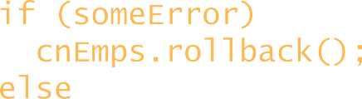

Using Transactions
Transactions are essential in enterprise applications
Transactions ensure the database remains consistent, by grouping related SQL statements into "all-or-nothing" bundles
Commit or rollback all the statements within a transaction
There are several ways to manage transactions
Using JDBC function calls in your Java app
Using SQL in a stored proc (ROLLBACK/COMMIT TRANSACTION)
Using transactions in Java:
cnEmps.setAutoCommit(false);
…
if (someError) cnEmps.rollback();
else
cnEmps.commit();
cnEmps.setAutoCommit(true);

Slide 182
Obtaining Metadata
What is Metadata?
Getting Metadata for a Database
Getting Metadata for a Result Set

Slide 183
What is Metadata?
Metadata = "data about data" ☺
JDBC defines two Java interfaces, to allow you to obtain metadata about the database or a particular result set
<<interface>> DatabaseMetaData
<<interface>> ResultSetMetaData
Provides information about the types and properties of columns in a result set

Slide 184

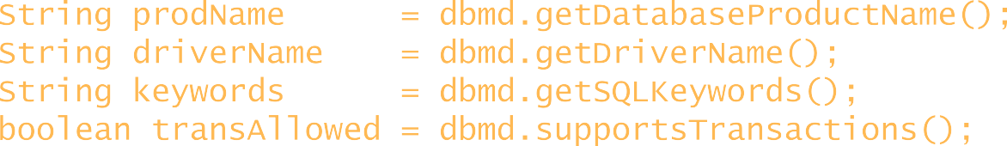
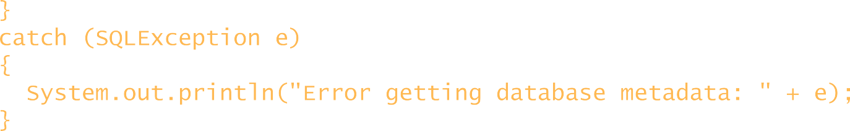
Getting Metadata for the Database
To obtain metadata for the database as a whole, call the getMetaData() method on a Connection object
This method returns a DatabaseMetaData object
Connection cnEmps;
… try
{
DatabaseMetaData dbmd = cnEmps.getMetaData();
String String String
prodName driverName keywords
= dbmd.getDatabaseProductName();
= dbmd.getDriverName();
= dbmd.getSQLKeywords();
= dbmd.supportsTransactions();
boolean transAllowed
}
catch (SQLException e)
{
System.out.println("Error getting database metadata: "
}
+ e);

Slide 185



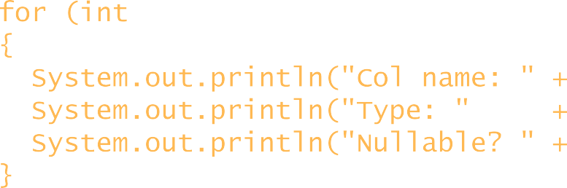
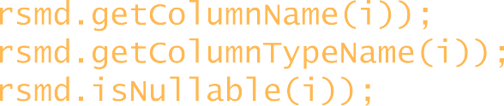
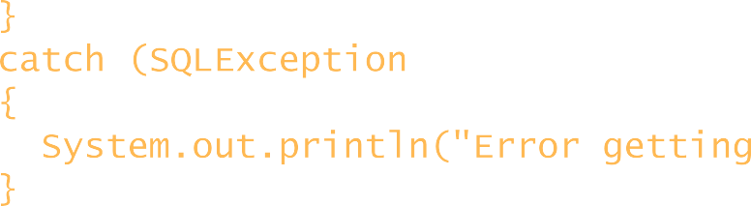
Getting Metadata for a Result Set
To obtain metadata for a particular result set, call the getMetaData() method on a ResultSet object
This method returns a ResultSetMetaData object
try
{
ResultSet rsEmps = st.executeQuery("SELECT * FROM MySchema.Employees"); ResultSetMetaData rsmd = rsEmps.getMetaData();
int columnCount = for (int i = 1; i
{
rsmd.getColumnCount();
<= columnCount; i++)
System.out.println("Col name: System.out.println("Type: " System.out.println("Nullable?
" + rsmd.getColumnName(i));
+ rsmd.getColumnTypeName(i)); " + rsmd.isNullable(i));
}
}
catch (SQLException e)
{
System.out.println("Error getting
}
resultset metadata: " + e);

Slide 186
Additional Techniques
Overview
Savepoints
Scrollable and Updatable Result Sets
RowSets
Batch Updates
Additional SQL Data Types

Slide 187
Overview
Additional Features:
Savepoints, for transactional control
Scrollable and updatable result sets, for programming simplicity
Batch updates, to reduce network costs
Rowsets
New SQL data types, e.g. to support BLOBs and CLOBs
Also, the JDBC Standard Extension offers optional extensions in a new package, javax.sql
Pooled database connections, for scalability
Named data sources, for ease of deployment and administration
Distributed transactions, for enterprise application integration

Slide 188
JDBC provides a java.sql.Savepoint interface
Database Management Systems
Gives you additional transactional control
Supported by most modern database systems
When you set a savepoint, you define a logical rollback point within a transaction
If an error occurs past a savepoint …
You can use the rollback() method to undo either all the changes or only the changes made after the savepoint

Slide 189
The Connection object has several methods that help you manage savepoints:
Database Management Systems
Create a new savepoint, and return it as a Savepoint object
SavePoint setSavepoint(String savepointName)
Delete the specified savepoint
void releaseSavepoint(Savepoint savepoint)
Rollback to the specified savepoint
void rollback(Savepoint savepoint)

Slide 190

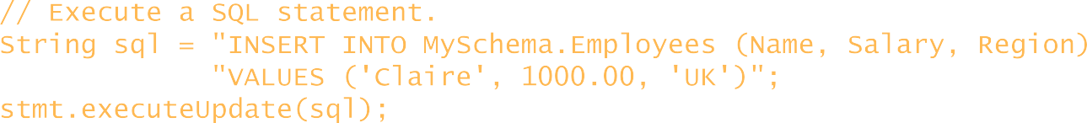


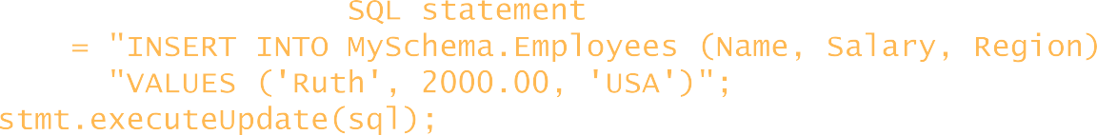

Database Management Systems
Connection cn = … ; Savepoint savepoint1 = null;
try { cn.setAutoCommit(false);
Statement stmt = cn.createStatement();
// Execute a SQL statement.
String sql = "INSERT INTO MySchema.Employees (Name, Salary, Region) " + "VALUES ('Claire', 1000.00, 'UK')";
stmt.executeUpdate(sql);
// Create a savepoint.
savepoint1 = cn.setSavepoint("Savepoint1");
// Execute another SQL statement.
sql = "INSERT INTO MySchema.Employees (Name, "VALUES ('Ruth', 2000.00, 'USA')";
stmt.executeUpdate(sql);
// If there is no error, commit the changes. cn.commit();
Salary,
Region) " +
}
catch (SQLException se){
// If there is any error, rollback cn.rollback(savepoint1);
to the savepoint.

Slide 191


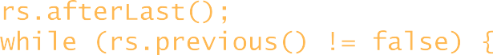
Scrollable and Updatable Result Sets
JDBC supports scrollable and/or updatable result sets
1st parameter to createStatement() indicates the scrollability
2nd parameter to createStatement() indicates the updatability
Connection cn = DriverManager.getConnection(…);
Statement st = cn.createStatement( ResultSet.TYPE_SCROLL_SENSITIVE, ResultSet.CONCUR_UPDATABLE);
ResultSet rs = st.executeQuery(
"SELECT EmployeeID, Name, Region FROM MySchema.Employees " + "WHERE REGION='London'");
rs.afterLast();
while (rs.previous() != false) {
System.out.println("Employee name: " + rs.getString("Name")); rs.updateString("Region", "Bracknell");
rs.updateRow();
}

Slide 192
JDBC has a RowSet interface
Database Management Systems
Defined in the javax.sql.rowset package
Follows the JavaBean convention for properties and events
Also supports scrollable and updateable result sets
There are two categories of RowSet…
Connected RowSets
Opens a connection Keeps the connection open for as long as the RowSet object is in use
E.g. JDBCRowSet interface
Thin wrapper over a ResultSet object, makes it look like a JavaBean to simplify integration with your other code
Disconnected RowSets Gets a connection to a Fills itself with data Closes the data source
 | data source
Ideal for sending data over a network because it allows offline data access

Slide 193
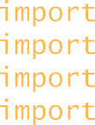
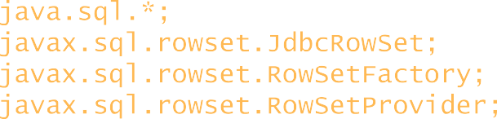
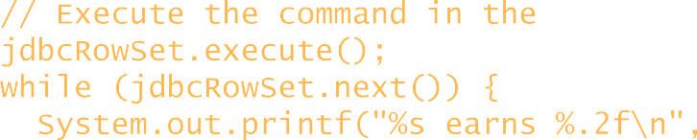
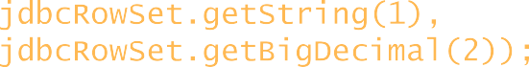
Example of how to use a rowset in Java SE 7:
Database Management Systems
import import import import
…
java.sql.*; javax.sql.rowset.JdbcRowSet; javax.sql.rowset.RowSetFactory; javax.sql.rowset.RowSetProvider;
// Create a JdbcRowSet object.
RowSetFactory rowSetFactory = RowSetProvider.newFactory(); JdbcRowSet jdbcRowSet = rowSetFactory.createJdbcRowSet();
// Configure the JdbcRowSet object. jdbcRowSet.setUrl("jdbc:derby://localhost:1527/C:/JavaDev/Databases/MyDatabase"); jdbcRowSet.setType(ResultSet.TYPE_SCROLL_INSENSITIVE); jdbcRowSet.setCommand("SELECT Name, Salary FROM MySchema.Employees");
// Execute the command in the jdbcRowSet.execute();
while (jdbcRowSet.next()) { System.out.printf("%s earns
JdbcRowSet, and iterate through the results.
%.2f\n", jdbcRowSet.getString(1), jdbcRowSet.getBigDecimal(2));
}

Slide 194
Batch Updates
JDBC supports batch updates
Use metadata to see if a driver/database supports batch updates
Call addBatch() to add SQL statements to a batch
Call executeBatch() to execute the batched statements
Connection cnEmps = DriverManager.getConnection(…);
DatabaseMetaData dbmd = cnEmps.getMetaData(); if (dbmd.supportsBatchUpdates()) {
cnEmps.setAutoCommit(false);
Statement st = cnEmps.createStatement();
st.addBatch("INSERT MySchema.Employees VALUES('Craig', 99000, 'Wales')"); st.addBatch("DELETE MySchema.Employees WHERE Salary > 750001");
int[] rowsAffected = st.executeBatch(); cnEmps.commit();
}

Slide 195
Additional SQL Data Types
JDBC supports the following additional SQL data types
java.sql.Blob :
java.sql.Clob :
java.sql.Array :
java.sql.Struct :
java.sql.Ref :
BLOB (binary large object) CLOB (character large object)
SQL array of primitive/structured types Structured type
Reference to structured type
Corresponding get/set methods, for example:
getBlob() and setBlob()
getClob() and setClob()

Slide 196
Advanced Java - Day 4
Notes:
Hello and welcome to this session on bonds trading.

Slide 197
Agenda
In this session, you will learn about:
JSP
Servlets
Java Script

Slide 198
JSP

Slide 199
Fundamentals
Classes and interfaces specific to JSP
Package javax.servlet.jsp
Package javax.servlet.jsp.tagext
Key components
Directives
Actions
Scriptlets
Tag libraries
Implicit Objects

Slide 200
Fundamentals
JSPs
Look like standard HTML or XHTML
Normally include HTML or XHTML markup
Known as fixed-template data
Used when content is mostly fixed-template data
Small amounts of content generated dynamically
Servlets
Used when small amount of content is fixed-template data
Most content generated dynamically

Slide 201
JSP Architecture
JSPs run in two phases
Translation Phase
Execution Phase
In translation phase JSP page is compiled into a servlet
called JSP Page Implementation class
In execution phase the compliled JSP is processed

Slide 202
JSP Architecture
HTTP Server
JSP Container
Page Compiler Servlet
JSP Servlet
Current?
No
Parse JSP
Yes
JSP Servlet
Loaded?
Generate JSP
Servlet Source
Yes
No
Load Servlet
Compile JSP
Servlet
JSP Page Servlet
Generate
Response

Slide 203
Lifecycle of a JSP
A JSP life cycle can be defined as the entire process from its creation till the destruction which is similar to a servlet life cycle with an additional step which is required to compile a JSP into servlet.
The following are the paths followed by a JSP
Compilation
Initialization
Execution
Cleanup

Slide 204
JSP Compilation
When a browser asks for a JSP, the JSP engine first checks to see whether it needs to compile the page. If the page has never been compiled, or if the JSP has been modified since it was last compiled, the JSP engine compiles the page.
The compilation process involves three steps:
Parsing the JSP
Turning the JSP into a servlet
Compiling the servlet

Slide 205
JSP Initialization
When a container loads a JSP it invokes the jspInit() method before servicing any requests. If you need to perform JSP-specific initialization, override the jspInit() method:
public void jspInit(){ // Initialization code... }Typically initialization is performed only once and as with the servlet init method, you generally initialize database connections, open files, and create lookup tables in the jspInit method.

Slide 206
JSP Execution
This phase of the JSP life cycle represents all interactions with requests until the JSP is destroyed.
Whenever a browser requests a JSP and the page has been loaded and initialized, the JSP engine invokes the _jspService() method in the JSP.
The _jspService() method takes an HttpServletRequest and an HttpServletResponse as its parameters as follows:
void _jspService(HttpServletRequest request, HttpServletResponse response) { // Service handling code... }The _jspService() method of a JSP is invoked once per a request and is responsible for generating the response for that request and this method is also responsible for generating responses to all seven of the HTTP methods ie. GET, POST, DELETE etc.

Slide 207
JSP Cleanup
The destruction phase of the JSP life cycle represents when a JSP is being removed from use by a container.
The jspDestroy() method is the JSP equivalent of the destroy method for servlets. Override jspDestroy when you need to perform any cleanup, such as releasing database connections or closing open files.
The jspDestroy() method has the following form:
public void jspDestroy() { // Your cleanup code goes here. }

Slide 208
Types of Data
A JSP page can have two types of data:
Template Data: It is the static part of a jsp page.
JSP Elements: It is the dynamic part of a jsp page.

Slide 209
Fixed template data
Fixed template data is any tag that a JSP engine passes straight through to the browser without modifying. It is the static part of a jsp page. Anything that is copied as it is directly to the response by the JSP server is known as template data.
In simple cases this data will take the form of plain HTML.
This text can be written anywhere in the JSP file

Slide 210
JSP Elements
It is the dynamic part of a jsp page. Anything that is translated and executed by the JSP server is known as JSP element.
There are three types of JSP elements:
Scripting Element
Directive Elements
Action Element

Slide 211
Scripting Element
A JSP element is an element that provides embedded Java statements. A JSP page can have three types of scripting elements:Declaration Element, Scriptlet Element, Expression Element.
Declaration Element
A declaration declares one or more variables or methods that you can use in Java code later in the JSP file. You must declare the variable or method before you use it in the JSP file.

Slide 212
Scripting Elements
Syntax
<%! Java decalaration statements %>
Following is the simple example for JSP Declarations:
<%! int i = 0; %>
<%! int a, b, c; %>
<%! Circle a = new Circle(2.0); %>

Slide 213
JSP Expression
A JSP expression element contains a scripting language expression that is evaluated, converted to a String, and inserted where the expression appears in the JSP file.
Because the value of an expression is converted to a String, you can use an expression within a line of text, whether or not it is tagged with HTML, in a JSP file.
The expression element can contain any expression that is valid according to the Java Language Specification but you cannot use a semicolon to end an expression.
Following is the syntax of JSP Expression:
<%= expression %>

Slide 214
Scripting Elements
Following is the simple example for JSP Expression:
<html>
<head>
<title>A Comment Test</title>
</head>
<body>
<p>
Today's date: <%= (new java.util.Date()).toLocaleString()%>
</p>
</body>
</html>
This would generate following result:
Today's date: 21-May-2013 21:24:25

Slide 215
Scriptlet
A scriptlet can contain any number of JAVA language statements, variable or method declarations, or expressions that are valid in the page scripting language.
Following is the syntax of Scriptlet:
<% code fragment %>

Slide 216
Scripting Elements
Any text, HTML tags, or JSP elements you write must be outside the scriptlet.
Following is the simple and first example for JSP:
<html>
<head>
<title>Hello World</title>
</head>
<body> Hello World!<br/>
<% out.println("Your IP address is " + request.getRemoteAddr()); %>
</body>
</html>

Slide 217
JSP Directives
JSP directives provide directions and instructions to the container, telling it how to handle certain aspects of JSP processing.
Syntax
<%@ directive attribute="value" %>
Directives can have a number of attributes which you can list down as key-value pairs and separated by commas.

Slide 218
JSP Directives
There are three types of directive tag:
DirectiveDescription
<%@ page ... %>Defines page-dependent attributes, such as scripting language, error page, and buffering requirements.
<%@ include ... %>Includes a file during the translation phase.
<%@ taglib ... %>Declares a tag library, containing custom actions, used in the page

Slide 219
The page Directive
The page directive is used to provide instructions to the container that pertain to the current JSP page. You may code page directives anywhere in your JSP page.
By convention, page directives are coded at the top of the JSP page.
Following is the basic syntax of page directive:
<%@ page attribute="value" %>
Notes:
: Refer word document for Listing 1

Slide 220
The include Directive
The include directive is used to includes a file during the translation phase. This directive tells the container to merge the content of other external files with the current JSP during the translation phase. You may code include directives anywhere in your JSP page.
The general usage form of this directive is as follows:
<%@ include file="relative url" >
The filename in the include directive is actually a relative URL. If you just specify a filename with no associated path, the JSP compiler assumes that the file is in the same directory as your JSP

Slide 221
The taglib Directive
The JavaServer Pages API allows you to define custom JSP tags that look like HTML or XML tags and a tag library is a set of user-defined tags that implement custom behavior.
The taglib directive declares that your JSP page uses a set of custom tags, identifies the location of the library, and provides a means for identifying the custom tags in your JSP page.
The taglib directive follows the following syntax:
<%@ taglib uri="uri" prefix="prefixOfTag" >Where the uri attribute value resolves to a location the container understands and the prefix attribute informs a container what bits of markup are custom actions

Slide 222
JSP - Actions
Action elements are certain directives that are givento the container perform certain task during theexecution of a JSP page. You can dynamically insert a file, reuse JavaBeans components, forward the user to another page, or generate HTML for the Java plugin.
There is only one syntax for the Action element, as it conforms to the XML standard:
<jsp:action_name attribute="value" />
Notes:
:Refer word document for Listing 2

Slide 223
Common Attributes
There are two attributes that are common to all Action elements: the id attribute and the scope attribute.
Id attribute: The id attribute uniquely identifies the Action element, and allows the action to be referenced inside the JSP page.
Scope attribute: This attribute identifies the lifecycle of the Action element. The id attribute and the scope attribute are directly related, as the scope attribute determines the lifespan of the object associated with the id. The scope attribute has four possible values: (a) page, (b)request, (c)session, and (d) application.

Slide 224
The <jsp:include> Action
This action lets you insert files into the page being generated. The syntax looks like this:
<jsp:include page="relative URL“ />
Unlike the include directive, which inserts the file at the time the JSP page is translated into a servlet, this action inserts the file at the time the page is requested.

Slide 225
The <jsp:useBean> Action
The useBean action is quite versatile. It first searches for an existing object utilizing the id and scope variables. If an object is not found, it then tries to create the specified object.
The simplest way to load a bean is as follows:
<jsp:useBean id="name" class="package.class" />
Once a bean class is loaded, you can use jsp:setProperty and jsp:getProperty actions to modify and retrieve bean properties.

Slide 226
The <jsp:setProperty> Action
The setProperty action sets the properties of a Bean. The Bean must have been previously defined before this action.
Example
<jsp:useBean id="myName" ... /> ... <jsp:setProperty name="myName" property="someProperty“ value=“abc”/>

Slide 227
The <jsp:getProperty> Action
The getProperty action is used to retrieve the value of a given property and converts it to a string, and finally inserts it into the output.
Example
<jsp:useBean id="myName" ... /> ... <jsp:getProperty name="myName" property="someProperty" .../>

Slide 228
The <jsp:forward> Action
The forward action terminates the action of the current page and forwards the request to another resource such as a static page, another JSP page, or a Java Servlet.
The simple syntax of this action is as follows:
<jsp:forward page="Relative URL" />
The <jsp:text> Action
The <jsp:text> action can be used to write template text in JSP pages and documents. Following is the simple syntax for this action:
<jsp:text>Template data</jsp:text>

Slide 229
The <jsp:param> Action
Used in conjunction with Include & Forward actions to include additional request parameters to the included or forwarded resource
Example
<jsp:forward page=“Param2.jsp”>
<jsp:param name=“FirstName” value=“Sanjay”>
</jsp:forward>
This will result in the forwarded resource having an additional parameter FirstName with a value of Sanjay

Slide 230
The < jsp: plugin > Action
Enables the JSP container to render appropriate HTML (based on the browser type) to:
Initiate the download of the Java plugin
Execution of the specified applet or bean
plugIn standard action allows the applet to be embedded in a browser neutral fashion
Example
<jsp: plugin type=“applet” code=“MyApplet.class” codebase=“/”>
<jsp:params>
<jsp:param name=“myParam” value=“122”/>
</jsp:params>
<jsp:fallback><b>Unable to load applet</b></jsp:fallback>
</jsp:plugin>

Slide 231
JSP Tags
Another important syntax element of JSP are tags. JSP tags do not use <%, but just the < character. A JSP tag is somewhat like an HTML tag. JSP tags can have a "start tag", a "tag body" and an "end tag". The start and end tag both use the tag name, enclosed in < and > characters. The end starts with a / character after the < character. The tag names have an embedded colon character : in them, the part before the colon describes the type of the tag.
For instance:
<some:tag> body </some:tag>
If the tag does not require a body, the start and end can be conveniently merged together, as
<some:tag/>

Slide 232
JSP Tags
Tags can be of two types: loaded from an external tag library, or predefined tags.
Predefined tags start with jsp: characters. For instance,jsp:include is a predefined tag that is used to include other pages.
Following is an example of jsp:include usage
<HTML>
<BODY>
Going to include hello.jsp...<BR> <jsp:include page="hello.jsp"/>
</BODY>
</HTML>

Slide 233
JSP Tags
The JavaServer Pages Standard Tag Library (JSTL) is a collection of useful JSP tags which encapsulates core functionality common to many JSP applications.
The JSTL tags can be classified, according to their functions, into following JSTL tag library groups that can be used when creating a JSP page:
Core Tags
Formatting tags
SQL tags
XML tags
JSTL Functions

Slide 234
JSP Tags
To use any of the libraries, you must include a <taglib> directive at the top of each JSP that uses the library.
Core Tags:
The core group of tags are the most frequently used JSTL tags. Following is the syntax to include JSTL Core library in your JSP:
<%@ taglib prefix="c" uri="http://java.sun.com/jsp/jstl/core" %>

Slide 235
Formatting Tags
The JSTL formatting tags are used to format and display text, the date, the time, and numbers for internationalized Web sites. Following is the syntax to include Formatting library in your JSP:
<%@ taglib prefix="fmt" uri="http://java.sun.com/jsp/jstl/fmt" %>

Slide 236
SQL Tags
The JSTL SQL tag library provides tags for interacting with relational databases (RDBMSs) such as Oracle, mySQL, or Microsoft SQL Server.
Following is the syntax to include JSTL SQL library in your JSP: <%@ taglib prefix="sql" uri="http://java.sun.com/jsp/jstl/sql" %>

Slide 237
XML Tags
The JSTL XML tags provide a JSP-centric way of creating and manipulating XML documents. Following is the syntax to include JSTL XML library in your JSP.
The JSTL XML tag library has custom tags for interacting with XML data. This includes parsing XML, transforming XML data, and flow control based on XPath expressions.
<%@ taglib prefix="x" uri="http://java.sun.com/jsp/jstl/xml" %>

Slide 238
JSTL Functions
JSTL includes a number of standard functions, most of which are common string manipulation functions. Following is the syntax to include JSTL Functions library in your JSP:
<%@ taglib prefix="fn" uri="http://java.sun.com/jsp/jstl/functions" %>

Slide 239
JSP Implicit Objects
JSP Implicit Objects are the Java objects that the JSP Container makes available to developers in each page and developer can call them directly without being explicitly declared.
JSP Implicit Objects are also called pre-defined variables.
Notes:
Note8

Slide 240
JSP Exception
Exception Implicit Object
In JSP, exception is an implicit object of type java.lang.Throwable class. This object can be used to print the exception. But it can only be used in error pages.
Let's see a simple example:

Slide 241
JSP Exception
The exception is normally an object that is thrown at runtime. Exception Handling is the process to handle the runtime errors. There may occur exception any time in your web application. So handling exceptions is a safer side for the web developer. In JSP, there are two ways to perform exception handling:
By errorPage and isErrorPage attributes of page directive
By <error-page> element in web.xml file
Notes:
Refer Listing 18.1 in JSP.doc

Slide 242
The Request Object
The request object is an instance of a javax.servlet.http.HttpServletRequest object. Each time a client requests a page the JSP engine creates a new object to represent that request.
The request object provides methods to get HTTP header information including form data, cookies, HTTP methods etc.
Notes:
Note9

Slide 243
The Request Object
The response object is an instance of a javax.servlet.http.HttpServletResponse object. Just as the server creates the request object, it also creates an object to represent the response to the client. Through this object the JSP programmer can add new cookies or date stamps, HTTP status codes etc.
Example
response.setIntHeader("Refresh", 5);

Slide 244
The Out Object
The out implicit object is an instance of a javax.servlet.jsp.JspWriter object and is used to send content in a response.
Following are the important methods
out.print(dataType dt)Print a data type value
out.println(dataType dt)Print a data type value then terminate the line with new line character.
out.flush()Flush the stream.

Slide 245
The Session Object
The session object is an instance of javax.servlet.http.HttpSession and behaves exactly the same way that session objects behave under Java Servlets.
The session object is used to track client session between client requests.

Slide 246
The Application Object
The application object is direct wrapper around the ServletContext object for the generated Servlet and in reality an instance of a javax.servlet.ServletContext object.
By adding an attribute to application, you can ensure that all JSP files that make up your web application have access to it.
Example
application.setAttribute(String Key, Object Value);
application.getAttribute(String Key);

Slide 247
The Config Object
The config object is an instantiation of javax.servlet.ServletConfig and is a direct wrapper around the ServletConfig object for the generated servlet.
This object allows the JSP programmer access to the Servlet or JSP engine initialization parameters such as the paths or file locations etc.
The following config method is the only one you might ever use, and its usage is trivial:
config.getServletName();

Slide 248
The pageContext Object
The pageContext object is an instance of a javax.servlet.jsp.PageContext object. The pageContext object is used to represent the entire JSP page.
This object is intended as a means to access information about the page while avoiding most of the implementation details.
This object stores references to the request and response objects for each request. The application, config, session, and out objects are derived by accessing attributes of this object.
The pageContext object also contains information about the directives issued to the JSP page, including the buffering information, the errorPageURL, and page scope

Slide 249
The pageContext Object
The PageContext class defines several fields, including PAGE_SCOPE, REQUEST_SCOPE, SESSION_SCOPE, and APPLICATION_SCOPE, which identify the four scopes
One of the important methods is removeAttribute, which accepts either one or two arguments. For example, pageContext.removeAttribute ("attrName") removes the attribute from all scopes, while the following code only removes it from the page scope:
pageContext.removeAttribute("attrName", PAGE_SCOPE);

Slide 250
The page Object
This object is an actual reference to the instance of the page. It can be thought of as an object that represents the entire JSP page.
The page object is really a direct synonym for the this object.
The exception Object:
The exception object is a wrapper containing the exception thrown from the previous page. It is typically used to generate an appropriate response to the error condition.
Notes:
Note10

Slide 251
Object Scopes
The availability of a JSP object for use from a particular place of the application is defined as the scope of that JSP object. Every object created in a JSP page will have a scope. Object scope in JSP is segregated into four parts and they are page, request, session and application.
There are four object scopes
Application scope
Objects owned by the container application
Any servlet or JSP can manipulate these objects
Page scope
Objects that exist only in page in which they are defined
Each page has its own instance of these objects
Request scope
Objects exist for duration of client request
Objects go out of scope when response sent to client
Session scope
Objects exist for duration of client’s browsing session
Objects go out of scope when client terminates session or when session timeout occurs

Slide 252
<c:url>
The <c:url> tag formats a URL into a string and stores it into a variable. This tag automatically performs URL rewriting when necessary. The var attribute specifies the variable that will contain the formatted URL.
Example:
<%@ taglib uri="http://java.sun.com/jsp/jstl/core" prefix="c" %>
<html>
<head>
<title>

Slide 253
<c:url> Tag Example
</title>
</head>
<body>
<a href="<c:url value="/jsp/index.htm"/>">TEST</a>
</body>
</html>
This would produce following result:
TEST
Notes:
Refer Listing 14 in the word document

Slide 254
<c:param>
The <c:param> tag allows proper URL request parameter to be specified with URL and it does any necessary URL encoding required.
Within a <c:param> tag, the name attribute indicates the parameter name, and the value attribute indicates the parameter value:

Slide 255
Example:
If you need to pass parameters to a <c:import> tag, use the <c:url> tag to create the URL first as shown below:
<c:url value="/index.jsp" var="myURL"> <c:param name="trackingId" value="1234"/> <c:param name="reportType" value="summary"/> </c:url>
<c:import url="${myURL}"/>
Above request would pass URL as below
"/index.jsp?trackingId=1234;reportType=summary“
Note: Refer Listing 15 in word document

Slide 256
<c:out>
The <c:out> tag displays the result of an expression, similar to the way <%= %> works with a difference that <c:out> tag lets you use the simpler "." notation to access properties.
For example, to access customer.address.street just use tag is
<c:out value="customer.address.street"/>.
Notes:
Refer Listing 17 in word document

Slide 257

Test Automation - JUnit
What is JUnit?
JUnit is an open source Unit Testing Framework for JAVA to write and run repeatable tests.
Erich Gamma and Kent Beck initially developed it.
It is an instance of xUnit architecture.
As the name implies, it is used for Unit Testing of a small chunk of code.

Slide 258
Servlets

Slide 259
Servlets
Java Servlets are programs that run on a Web or Application server and act as a middle layer between a request coming from a Web browser or other HTTP client and databases or applications on the HTTP server.
Using Servlets, you can collect input from users through web page forms, present records from a database or another source, and create web pages dynamically.

Slide 260
Servlets Tasks
Servlets perform the following major tasks:
Read the explicit data sent by the clients (browsers). This includes an HTML form on a Web page or it could also come from an applet or a custom HTTP client program.
Read the implicit HTTP request data sent by the clients (browsers). This includes cookies, media types and compression schemes the browser understands, and so forth.

Slide 261
Process the Data and Generate the Results
This process may require talking to a database, executing an RMI or CORBA call, invoking a Web service, or computing the response directly.
Send the explicit data (i.e., the document) to the clients (browsers). This document can be sent in a variety of formats, including text (HTML or XML), binary (GIF images), Excel, etc.
Send the implicit HTTP response to the clients (browsers). This includes telling the browsers or other clients what type of document is being returned (e.g., HTML), setting cookies and caching parameters, and other such tasks

Slide 262
Servlets – Java Classes
Servlets are java classes run by webserver
Servlets can be created using the javax.servlet and javax.servlet.http packages
Java Servlets are compiled like any other java class
Servlets are server side components that provide a powerful mechanism for developing server side programs

Slide 263
Servlet Lifecycle Consists of Four Stages
Servlet initialization by calling the init() method
Servlet calls service() method for processing a client's request.
Servlet is terminated by calling the destroy() method
Finally, servlet is garbage collected by the garbage collector of the JVM

Slide 264
Servlet Lifecycle – Init() method
It is called once when the servlet is first created and not called for each user request
When a user invokes a servlet, a single instance of each servlet is created
Each user request results in a new thread that is handed off to doGet or doPost
The init() method loads some data that will be used throughout the life of the servlet
The init method definition looks like this:
public void init() throws ServletException { // Initialization code... }

Slide 265
Service() method
The service() method is the main method which perform the actual task.
The servlet container (i.e. web server) calls the service() method to handle requests coming from the client and to send the response back to the client.
Each time the server receives a request for a servlet, the server spawns a new thread and calls service. The service() method checks the HTTP request type (GET, POST, PUT, DELETE, etc.) and calls doGet, doPost, doPut, doDelete, etc. methods as appropriate

Slide 266
Method definition
Public void service(ServletRequest request, ServletResponse response) throws ServletException, IOException{ }
Service method is called by container
It invokes doGet(), doPost() method
doGet() method
A GET request results from a normal request for a URL or from an HTML form that has no METHOD specified and it should be handled by doGet() method.
public void doGet(HttpServletRequest request, HttpServletResponse response) throws ServletException, IOException { // Servlet code }

Slide 267
doPost() Method
A POST request results from an HTML form that specifically lists POST as the METHOD and it should be handled by doPost() method.
public void doPost(HttpServletRequest request, HttpServletResponse response) throws ServletException, IOException { // Servlet code }

Slide 268
destroy() method
Called at the end of the lifecycle of the servlet
Method performs cleanup activities like closing the db connection
After the destroy() method is called, the servlet object is marked for garbage collection. The destroy method definition looks like this:
public void destroy() { // Finalization code... }

Slide 269
Servlet Example
Servlets are Java classes which service HTTP requests and implement the javax.servlet.Servletinterface.
Web application developers typically write servlets that extend javax.servlet.http.HttpServlet, an abstract class that implements the Servlet interface and is specially designed to handle HTTP requests.
Example class

Slide 270
Servlet Example
// Import required java libraries
import java.io.*;
import javax.servlet.*;
import javax.servlet.http.*;
// Extend HttpServlet class
public class Demo extends HttpServlet {
private String message;
public void init() throws ServletException {
// Do required initialization
message = “Demo"; }

Slide 271
Servlet Example
public void doGet(HttpServletRequest request, HttpServletResponse response) throws ServletException, IOException {
// Set response content type response.setContentType("text/html");
// Actual logic goes here.
PrintWriter out = response.getWriter(); out.println("<h1>" + message + "</h1>"); } public void destroy()
{ // do nothing.
}
}

Slide 272
Request and response
A Servlet is an object that receives a request and generates a response based on that request.
The basic Servlet package defines Java objects to represent servlet requests and responses, as well as objects to reflect the servlet's configuration parameters and execution environment.
The package javax.servlet.http defines HTTP-specific subclasses of the generic servlet elements, including session management objects that track multiple requests and responses between the web server and a client. Servlets may be packaged in a WAR file as a web application.

Slide 273
Servlet class hierarchy
Most basic servlet definitions live in the javax.servlet package and consist of number of interfaces. Important ones are mentioned below
ServletContext interface: Defines a set of methods that a servlet uses to communicate with its servlet container, for example, to get the MIME type of a file, dispatch requests, or write to a log file, request for system resources.
There is one context per "web application“.
The ServletContext object is contained within the ServletConfig object, which the Web server provides the servlet when the servlet is initialized.
Servlet.getServletConfig(), ServletConfig.getServletContext()

Slide 274
Servlet Class Hierarchy
ServletConfig Interface: A servlet configuration object used by a servlet container/ web server to pass initialization. information to a servlet’s init() method. The information is in the form of name/value pairs
Servlet Interface: Defines methods that all servlets must implement. This interface defines the three lifecycle methods. To implement this interface, you can write a generic servlet that extends javax.servlet.GenericServlet or an HTTP servlet that extends javax.servlet.http.HttpServlet.
In addition to the life-cycle methods, this interface provides the getServletConfig method, which the servlet can use to get any startup information, and the getServletInfo method, which allows the servlet to return basic information about itself, such as author, version, and copyright.
Notes:
Refer Note End in Servlet.doc

Slide 275
Core Servlet API
Generic Servlet: public abstract class GenericServlet extends java.lang.Object implements Servlet, ServletConfig, java.io.Serializable
Defines a generic, protocol-independent servlet.
To write an HTTP servlet for use on the Web, extend HttpServlet instead.
GenericServlet implements the Servlet and ServletConfig interfaces. GenericServlet may be directly extended by a servlet, although it's more common to extend a protocol-specific subclass such as HttpServlet.
GenericServlet makes writing servlets easier. It provides simple versions of the lifecycle methods init and destroy and of the methods in the ServletConfig interface. GenericServlet also implements the log method, declared in the ServletContext interface.
To write a generic servlet, you need only override the abstract service method.

Slide 276
ServletRequest Interface
Public interface ServletRequest:
Defines an object to provide client request information to a servlet. The servlet container creates a ServletRequest object and passes it as an argument to the servlet's service method.
A ServletRequest object provides data including parameter name and values, attributes, and an input stream. Interfaces that extend ServletRequest can provide additional protocol-specific data (for example, HTTP data is provided by HttpServletRequest)
It resides in javax.servlet package

Slide 277
ServletResponse Interface
Public interface ServletResponse
Defines an object to assist a servlet in sending a response to the client.
The servlet container creates a ServletResponse object and passes it as an argument to the servlet's service method.
To send binary data in a MIME body response, use the ServletOutputStream returned by getOutputStream().
To send character data, use the PrintWriter object returned by getWriter().

Slide 278
ServletInputStream
public abstract class ServletInputStream extends java.io.InputStream
Provides an input stream for reading binary data from a client request, including an efficient readLine method for reading data one line at a time.
A ServletInputStream object is normally retrieved via the ServeletRequest.getInputStream() method.

Slide 279
ServletOutputStream
public abstract class ServletOutputStream extends java.io.OutputStream
Provides an output stream for sending binary data to the client.
A ServletOutputStream object is normally retrieved via the ServletResponse.getOutputStream() method.

Slide 280
Http Servlet
It is contained in javax.servlet.http package
public abstract class HttpServlet extends GenericServlet implements java.io.Serializable
Provides an abstract class to be subclassed to create an HTTP servlet suitable for a Web site. A subclass of HttpServlet must override at least one method, usually one of these:
doGet, if the servlet supports HTTP GET requests
doPost, for HTTP POST requests
doPut, for HTTP PUT requests
doDelete, for HTTP DELETE requests
init and destroy, to manage resources that are held for the life of the servlet
getServletInfo, which the servlet uses to provide information about itself

Slide 281
Http Servlet
There's almost no reason to override the service method. service handles standard HTTP requests by dispatching them to the handler methods for each HTTP request type (the doXXX methods listed above).
Servlets typically run on multithreaded servers, so be aware that a servlet must handle concurrent requests and be careful to synchronize access to shared resources. Shared resources include in-memory data such as instance or class variables and external objects such as files, database connections, and network connections.

Slide 282
Http Servlet
This class’s service method takes HttpServletRequest and HttpServletResponse
Objects instead of the generic version
HttpServlet’s built-in service() method looks at the request received and calls an appropriate method to handle it
Example if the request is an HTTP GET, doGet() will be called.
We can override appropriate do methods which we want in our servlet and if any other request comes in the servlet will report that it does not handle it.

Slide 283
HTTPServletRequest
public interface HttpServletRequestextends ServletRequest
The servlet container creates an HttpServletRequest object and passes it as an argument to the servlet's service methods (doGet, doPost, etc).
The request object provides a lot of important information
One important type of information provided is list of cookies.
Cookies are used to exchange small piece of data between client browser and server website

Slide 284
Cookies
Cookies are represented by javx.servlet.http.Cookie class
getCookies
Cookie[] getCookies() method
Returns an array containing all of the Cookie objects the client sent with this request. This method
returns null if no cookies were sent.
Notes:
Table 4 in doc

Slide 285
HTTP Servlet
Cookie[] getCookies() Returns an array containing all of the Cookie objects the client sent with this request.
Enumeration getAttributeNames() Returns an Enumeration containing the names of the attributes available to this request.
Enumeration getHeaderNames() Returns an enumeration of all the header names this request contains.
Enumeration getParameterNames() Returns an Enumeration of String objects containing the names of the parameters contained in this request.

Slide 286
HTTP Servlet
HttpSession getSession() Returns the current session associated with this request, or if the request does not have a session, creates one.
Object getAttribute(String name) Returns the value of the named attribute as an Object, or null if no attribute of the given name exists.
String getParameter(String name) Returns the value of a request parameter as a String, or null if the parameter does not exist.
String getMethod() Returns the name of the HTTP method with which this request was made, for example, GET, POST, or PUT.
Notes:
Listing1

Slide 287
HTTPServletResponse Interface
public interface HttpServletResponse extends ServletResponse
Extends the ServletResponse interface to provide HTTP-specific functionality in sending a response. For example, it has methods to access HTTP headers and cookies.
The servlet container creates an HttpServletResponse object and passes it as an argument to the servlet's service methods (doGet, doPost, etc).

Slide 288
HTTP Servlet
The response object is where the servlet can write information about data it will send back
When a Web server responds to a HTTP request to the browser, the response typically consists of a status line, some response headers, a blank line, and the document
Important methods to set HTTP response headers. These method are available with HttpServletResponse object.
void setContentLength(int len) Sets the length of the content body in the response In HTTP servlets, this method sets the HTTP Content-Length header.
Notes:
Table 4

Slide 289
HTTP Servlet
void setContentType(String type) Sets the content type of the response being sent to the client, if the response has not been committed yet.
void setStatus(int sc) Sets the status code for this response.
String encodeURL(String url) Encodes the specified URL by including the session ID in it, or, if encoding is not needed, returns the URL unchanged.
boolean isCommitted() Returns a boolean indicating if the response has been committed.

Slide 290
HTTP Servlet
void addCookie(Cookie cookie) Adds the specified cookie to the response.
void sendError(int sc) Sends an error response to the client using the specified status code and clearing the buffer.
void sendRedirect(String location) Sends a temporary redirect response to the client using the specified redirect location URL.
PrintWriter getWriter()
It returns a PrintWriter that the servlet uses to send its data.
ServletOutputStream getOutputStream()
ServletOutputStream contains a write(byte[]) method which is ideal for sending bytes of data
Notes:
Listing2

Slide 291
Accessing Parameters
Reading Form Data using Servlet:
Servlets handles form data parsing automatically using the following methods depending on the situation. All these methods are defined for Interface ServletRequest
getParameter
java.lang.String getParameter(java.lang.String name)
Returns the value of a request parameter as a String, or null if the parameter does not exist. Request parameters are extra information sent with the request. For HTTP servlets, parameters are contained in the query string or posted form data.You should only use this method when you are sure the parameter has only one value. If the parameter might have more than one value, use getParameterValues(java.lang.String)

Slide 292
getParameterValues
java.lang.String[] getParameterValues(java.lang.String name)
Returns an array of String objects containing all of the values the given request parameter has,
or null if the parameter does not exist.If the parameter has a single value, the array has a length
of 1.

Slide 293
getParameterNames
java.util.Enumeration<java.lang.String> getParameterNames()
Returns an Enumeration of String objects containing the names of the parameters contained in this request. If the request has no parameters, the method returns an empty Enumeration.
Notes:
Listing 3

Slide 294
Request Dispatcher Interface
The RequestDispatcher interface provides the facility for dispatching the request to another resource it may be html, servlet or jsp. This interface can be used to include the content of another resource also.
There are 2 methods defined in the interface
public void forward(ServletRequest request,
ServletResponse response)throws ServletException, java.io.IOException: Forwards a request from a servlet to another resource(servlet, jsp or html file) on the server
public void include(ServletRequest request,
ServletResponse response)throws ServletException, java.io.IOException: Includes the content of a resource(servlet, jsp or html file) in the response.
For constructing a RequestDispatcher object, you can use either
ServletRequest.getRequestDispatcher(String resource) method or ServletContext.getRequestDispatcher(String resource) method.
Note: Refer Listing5 in word document for example

Slide 295
ServletContext
We can share data with other web resources using ServletContext
The Servlet API provides the class javax.servlet.ServletContext, which has methods that work with data stored in context. Any servlet can store Java objects in that context and other servlets can use them. The objects are stored with a String key for uniqueness.
There is one context per "web application" per Java Virtual Machine. (A "web application" is a collection of servlets and content installed under a specific subset of the server's URL namespace such as/catalog and possibly installed via a .war file.)
In the case of a web application marked "distributed" in its deployment descriptor, there will be one context instance for each virtual machine. In this situation, the context cannot be used as a location to share global information (because the information won't be truly global). Use an external resource like a database instead.

Slide 296
Here's how it works
Use setAttribute(String key, Object value) to store an attribute in context. key is the name of the attribute and value is the Java object to be stored.
Use getAttribute(String key) to retreive the Java object corresponding to the value of key in context. If no object is found, null is returned.
Remove attributes from context using remove(String key).

Slide 297
Servlet Config
An object of ServletConfig is created by the web container for each servlet. This object can be used to get configuration information from web.xml file
If the configuration information is modified from the web.xml file, we don't need to change the servlet. So it is easier to manage the web application if any specific content is modified from time to time.

Slide 298
Methods
The core advantage of ServletConfig is that you don't need to edit the servlet file if information is
modified from the web.xml file.
Methods of ServletConfig interface
public String getInitParameter(String name):Returns the parameter value for the specified parameter name.
public Enumeration getInitParameterNames():Returns an enumeration of all the initialization parameter names.
public String getServletName():Returns the name of the servlet.
public ServletContext getServletContext():Returns an object of ServletContext.

Slide 299
How to get the object of ServletConfig
How to get the object of ServletConfig
getServletConfig() method of Servlet interface returns the object of ServletConfig.
Syntax of getServletConfig() method
public ServletConfig getServletConfig();
Example of getServletConfig() method
ServletConfig config=getServletConfig();
//Now we can call the methods of ServletConfig interface

Slide 300
Example of ServletConfig to get Initialization Parameter
In this example, we are getting the one initialization parameter from the web.xml file and printing this information in the servlet.
DemoServlet.java
import java.io.*;
import javax.servlet.*;
import javax.servlet.http.*;
public class DemoServlet extends HttpServlet {
public void doGet(HttpServletRequest request, HttpServletResponse response)
throws ServletException, IOException {
response.setContentType("text/html");
PrintWriter out = response.getWriter();
ServletConfig config=getServletConfig();
String driver=config.getInitParameter("driver");
out.print("Driver is: "+driver);
out.close();
}
}

Slide 301
web.xml
web.xml
<web-app>
<servlet>
<servlet-name>DemoServlet</servlet-name>
<servlet-class>DemoServlet</servlet-class>
<init-param>
<param-name>driver</param-name>
<param-value>sun.jdbc.odbc.JdbcOdbcDriver</param-value>
</init-param>
</servlet>
<servlet-mapping>
<servlet-name>DemoServlet</servlet-name>
<url-pattern>/servlet1</url-pattern>
</servlet-mapping>
</web-app>

Slide 302
SendRedirect in servlet
The sendRedirect() method of HttpServletResponse interface can be used to redirect response to another resource, it may be servlet, jsp or html file.
It accepts relative as well as absolute URL.
It works at client side because it uses the url bar of the browser to make another request. So, it can work inside and outside the server.

Slide 303
Syntax of sendRedirect() method
public void sendRedirect(String URL)throws IOException;
Example of sendRedirect() method
response.sendRedirect("http://www.java.com");

Slide 304
Full example of sendRedirect method in servlet
In this example, we are redirecting the request to the google server. Notice that sendRedirect method works at client side, that is why we can our request to anywhere. We can send our request within and outside the server.
DemoServlet.java
import java.io.*;
import javax.servlet.*;
import javax.servlet.http.*;
public class DemoServlet extends HttpServlet{
public void doGet(HttpServletRequest req,HttpServletResponse res)
throws ServletException,IOException
{
res.setContentType("text/html");
PrintWriter pw=res.getWriter();
response.sendRedirect("http://www.google.com");
pw.close();
}}

Slide 305
Cookies
Cookies are text files stored on the client computer and they are kept for various information tracking purpose. Java Servlets supports HTTP cookies.
There are three steps involved in identifying returning users:
Server script sends a set of cookies to the browser. For example name, age, or identification number etc.
Browser stores this information on local machine for future use.
When next time browser sends any request to web server then it sends those cookies information to the server and server uses that information to identify the user.

Slide 306
Cookies
A servlet will have access to the cookie through the request method request.getCookies() which returns an array of Cookie objects.
Following is the list of useful methods which you can use while manipulating cookies in servlet.
public String getDomain() This method gets the domain to which cookie applies
public String getName() This method returns the name of the cookie.

Slide 307
Cookies
public void setValue(String newValue) This method sets the value associated with the cookie.
public String getValue() This method gets the value associated with the cookie.
public void setPath(String uri) This method sets the path to which this cookie applies. If you don't specify a path, the cookie is returned for all URLs in the same directory as the current page as well as all subdirectories.
public String getPath() This method gets the path to which this cookie applies.

Slide 308
Setting Cookies with Servlet
Setting cookies with servlet involves three steps:
1) Creating a Cookie object:
You call the Cookie constructor with a cookie name and a cookie value, both of which are strings.
Cookie cookie = new Cookie("key","value");
Keep in mind, neither the name nor the value should contain white space or any of the following
characters:
[ ] ( ) = , " / ? @ : ;
2) Setting the maximum age:
You use setMaxAge to specify how long (in seconds) the cookie should be valid. Following would
set up a cookie for 24 hours.
cookie.setMaxAge(60*60*24);
3) Sending the Cookie into the HTTP response headers:
You use response.addCookie to add cookies in the HTTP response header as follows:
response.addCookie(cookie);
We can create multiple cookies

Slide 309
Reading Cookies with Servlet
Cookie cookie = null;
Cookie[] cookies = null;
cookies = request.getCookies();
if( cookies != null ){
for (int i = 0; i < cookies.length; i++){ cookie = cookies[i];
out.print("Name : " + cookie.getName( ) + ", "); out.print("Value: " + cookie.getValue( )+" <br/>"); } }
else{
out.println( "<h2>No cookies founds</h2>"); }
Cookie cookie = null;
Cookie[] cookies = null;
cookies = request.getCookies();
if( cookies != null ){
for (int i = 0; i < cookies.length; i++){ cookie = cookies[i];
out.print("Name : " + cookie.getName( ) + ", "); out.print("Value: " + cookie.getValue( )+" <br/>"); } }
else{
out.println( "<h2>No cookies founds</h2>"); }

Slide 310
Session Tracking
HTTP is a "stateless" protocol which means each time a client retrieves a Web page, the client opens a separate connection to the Web server and the server automatically does not keep any record of previous client request.
Still there are following three ways to maintain session between web client and web server
Cookies:
A webserver can assign a unique session ID as a cookie to each web client and for subsequent requests from the client they can be recognized using the recieved cookie.
This may not be an effective way because many time browser does not support a cookie

Slide 311
Session Tracking
Hidden Form Fields
<input type="hidden" name="sessionid" value="12345">
This entry means that, when the form is submitted, the specified name and value are automatically included in the GET or POST data. Each time when web browser sends request back, then session_id value can be used to keep the track of different web browsers.
This could be an effective way of keeping track of the session but clicking on a regular (<A HREF...>) hypertext link does not result in a form submission, so hidden form fields also cannot support general session tracking.

Slide 312
Session Tracking
URL Rewriting:
You can append some extra data on the end of each URL that identifies the session, and the server can associate that session identifier with data it has stored about that session.
For example, with http://abc.com/xyz.htm;sessionid=11233, the session identifier is attached as sessionid=11233 which can be accessed at the web server to identify the client.

Slide 313
Session Tracking
HttpSession Object
Servlet provides HttpSession Interface which provides a way to identify a user across more than one page request or visit to a Web site and to store information about that user.
The servlet container uses this interface to create a session between an HTTP client and an HTTP server. The session persists for a specified time period, across more than one connection or page request from the user.
You would get HttpSession object by calling the public method getSession() of HttpServletRequest, as below:
HttpSession session = request.getSession();

Slide 314
Session Tracking
Few important methods of HTTPSesion object are:
public Object getAttribute(String name)
This method returns the object bound with the specified name in this session, or null if no object is bound under the name.
public String getId()
This method returns a string containing the unique identifier assigned to this session.
public void invalidate()
This method invalidates this session and unbinds any objects bound to it.
public void setAttribute(String name, Object value)
This method binds an object to this session, using the name specified.
Notes:
End1 & End 2

Slide 315
Building blocks
JavaScript

Slide 316
What is ECMAScript?
A specification of a scripting language
Standardized by ECMAScript International
Used by applications to enable client-side scripting
First edition was published in June 1997
9 editions have been published till date
Latest edition is version 9, which was published in June 2018
language specification is available at this URL: ‘https://tc39.github.io/ecma262’

Slide 317
What is JavaScript?
An implementation of ECMAScript
1
2
Developed by Brendan Eich of Netscape in 1995
Named Mocha, later LiveScript, and finally JavaScript
3
4
Executes on a web browser
Used in conjunction with HTML to develop interactive & responsive web pages
5

Slide 318
What is ECMAScript 5?
1
The 5th edition also called ES5.
2
V5.1 was published in 2011.
3
The sixth edition ES6 (aka ES2015) was a major revision and is covered separately.
ES2015 adds significant new syntax for writing complex, large-scale applications.
4
5
We shall see only features available up to v5.1 initially.

Slide 319
What is ECMAScript?
ECMAScript
(Standard)
v1
(1997)
v2
(1998)
v3
(1999)
v4
v5
(2009)
v5.1
(2011)
v6
(2015)
v7
(2016)
v8
(2017)
v9
(2018)
JavaScript
(Implementation)

Slide 320
Setting Up Dev Environment
Following Software is needed for developing JavaScript Applications
3.
Other Popular Code Editors/ IDEs
1.
Node.js
2.
Visual Studio Code
4.
Web Browser

Slide 321
Setting Up Dev Environment
1. Node.js
An open source, cross-platform runtime environment for server-side JavaScript
Needed to run JavaScript without a browser support
Node can be downloaded and installed from following URL: https://nodejs.org/en/download/
2. Visual Studio Code
An open source IDE from Microsoft
Available for Windows, macOS and Linux
VS Code can be downloaded and installed from following URL: https://code.visualstudio.com/

Slide 322
Setting Up Dev Environment
3. Other Popular Code Editors/ IDEs
Sublime Text: https://www.sublimetext.com/
WebStorm: https://www.jetbrains.com/webstorm/
Atom: https://atom.io/
4. Web Browser
Google Chrome: https://www.google.com/chrome/
Mozilla Firefox: https://www.mozilla.org/en-US/firefox/new/

Slide 323


How To Run JavaScript Code?
1. Using Node.js
2. In the browser

Slide 324
How To Run JavaScript Code?
1. Using Node.js
Open an editor and create a file, say 01-01-hello-js.js. Type the following contents and save it.
function greet() {
console.log( 'Hello JavaScript' );
}
greet();
console.log is a built-in function that logs any parameter passed to it in the browser console.
Open terminal or command window (can be done from within VSCode, too.)
Navigate to the folder that contains the JavaScript file.
At the command prompt, run this command. Note that specifying extension ‘.js’ is optional. The ‘$’ is the command prompt and may be different in your computer.
You should see the following output on your screen
$ node 01-01-hello-js
Hello JavaScript
You should see this output.

Slide 325
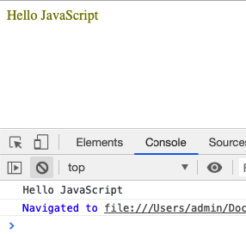
How To Run JavaScript Code?
2. In the browser
Create a web page, let us name it ’01-02-hello-js.html’ with the following code in the HTML page body.
Message div that is initially empty and also not styled.
This selects the message div by id and sets up HTML within it.
<body>
<div id="message"></div>
<script>
function greet() {
var message = 'Hello JavaScript';
console.log( message );
document.querySelector( ‘#message' ).innerHTML = message;
document.querySelector( ‘#message' ).style.color = 'olive’;
}
greet();
</script>
</body>
This selects the message div by id and sets up HTML within it.
Message logged in console.
Open the HTML page in a browser.
The message div HTML is set to “Hello JavaScript” and it gets olive color inline style.

Slide 326
Advanced Java - Day 5
Notes:
Hello and welcome to this session on bonds trading.

Slide 327
Agenda
In this session, you will learn about:
JUnit
Memory Management

Slide 328
JUnit

Slide 329

Why you need JUnit testing?
Developers who are following test-driven methodology must write and execute unit
test first before any code.
1
It finds bugs early in the code, which makes our code more reliable.
2
JUnit is useful for developers,
who work in a test-driven
environment.
3
Unit testing forces a developer
to read code more than writing.
You develop more readable, reliable and bug-free code which builds confidence during development.
4

Slide 330
JUnit – Test Fixtures
A test fixtures include:
Activities (allocation and de-allocation) required that makes these objects/resources available.
Objects or resources that are available for any test case.
1
2

Slide 331
Setup and Teardown
Usually, there are some repeated tasks that must be done prior to each test case.
Example: Create a database connection.
Likewise, at the end of each test case, there may be some repeated tasks.
Example: to clean up once test execution is over.
JUnit provides annotations that help in setup and teardown. It ensures that resources are released, and the test system is in a ready state for next test case.

Slide 332
What is JUnit Annotations?
Annotation is a special form of syntactic meta-data that can be added to Java source code for better code readability and structure.
Some of the JUnit annotations which can be useful are:
Before
After
BeforeClass
AfterClass
Ignore
RunWith
Test
Notes:
What is JUnit Annotations?
Annotation is a special form of syntactic meta-data that can be added to Java source code for better code readability and structure.
Variables, parameters, packages, methods and classes can be annotated.
Some of the JUnit annotations which can be useful are
Before
After
BeforeClass
AfterClass
Ignore
RunWith
Test

Slide 333
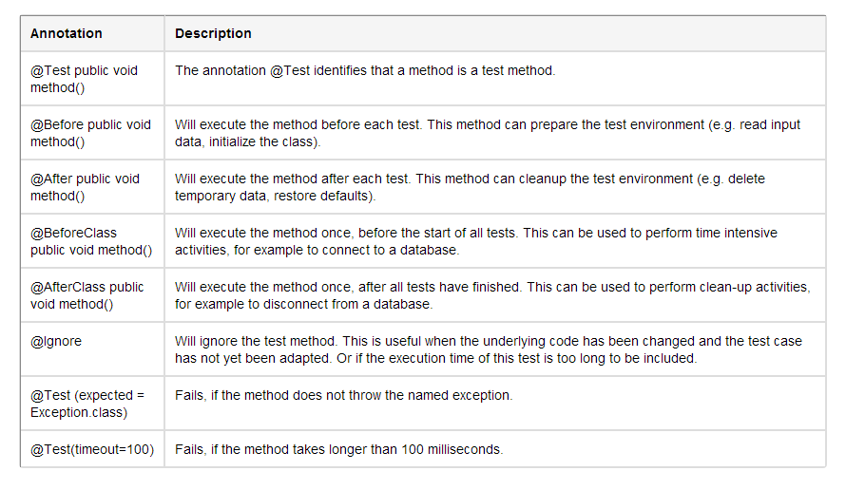
JUnit - Demo of Annotations

Slide 334
Summary
JDBC Drivers and Connections
JDBC is a standard API, for accessing data in any RDMBS
Load a JDBC driver, and use the driver manager to get a connection to a database
Statements and Results
JDBC defines three statement-related interfaces:
Statement, PreparedStatement, CallableStatement
Obtaining Metadata
Call aConnection.getMetaData() to get database metadata
Call aResultSet.getMetaData() to get resultset metadata
Additional Techniques
Additional APIs, offer new features such as scrollable/updatable result sets

Slide 335
Memory Management

Slide 336
Memory Management
Java has automatic Memory Management capability. Java Programmers are not bothered about the memory management stuff like:
Destroying Objects from the Memory
Keeping Track of the dereferenced objects getting accumulated in memory
Drawback:
Though Memory Management is automatic it does not ensure that the above tasks will be executed with 100% guarantee
Therefore there may be a situation where the entire memory is exhausted and programmers get “Out Of Memory” Error

Slide 337
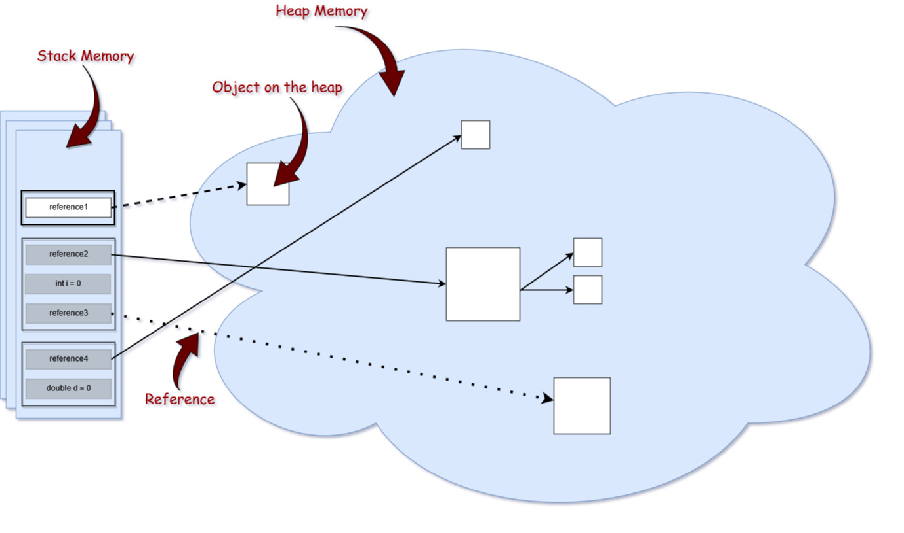
Memory Management
Solution: If programmers are aware of Memory Management then they can write optimized and high performance code.
Result: No “Out of Memory Scenario” with a fast performance.

Slide 338
Memory Management
Memory in general can be classified into:
Stack
Heap
Method Area
Permanent Generation Area (Special Area in Heap)

Slide 339
Memory Management
Stack: Stack memory is responsible for holding references to heap objects and for storing value of primitive types that belongs to a method. Method parameters are stored in Stack.
Heap: This part of memory stores the actual object in memory. It means that all the instance variables go into the Heap
Car c = new Car();
Here the car object will be stored in the Heap since we are using “new” to create an object in the memory of type Car. The c variable is the reference variable pointing to the Car object and this reference variable c is stored in the Stack.
Method Area : This memory is allocated for class structures, constant pool, method code, constructor codes etc. and also for interfaces or special method used in class.
Permanent Generation Area: All the information related to a class like name of the class, Object arrays associated with the class, internal objects used by JVM (like java/lang/Object) and optimization information goes into the Permanent Generation area.

Slide 340
Garbage Collector
Garbage Collector is a Daemon thread that keeps running in the background. Basically, it frees up the heap memory by destroying the unreachable objects.
If the garbage collector does not come into rescue then after a certain time programmer would get “Out of Memory” Error.
Unreachable objects are the ones that are no longer referenced by any part of the program.
However The Garbage collector of JVM collects only those objects that are created by new keyword.

Slide 341
Garbage Collector
JVM uses the finalize() method to do Garbage Collection.
The finalize() method is invoked each time before the object is garbage collected. This method can be used to perform cleanup processing. This method is defined in Object class as:
protected void finalize(){}
Object.finalize() can be overridden to specify what to do when a given object is garbage collected.

Slide 342
Garbage Collector
gc() method
The gc() method is used to invoke the garbage collector to perform cleanup processing. The gc() is found in System and Runtime classes. As a programmer we do not have any control on how and when the object will be destroyed even though we invoked the gc(). So it only runs the Garbage Collector.
public static void gc(){}
Example:
public class MyGarbageCollector{
public void finalize(){System.out.println("The Object is being garbage collected");}
public static void main(String args[]){
MyGarbageCollector s1=new MyGarbageCollector ();
MyGarbageCollector s2=new MyGarbageCollector ();
s1=null;
s2=null;
System.gc();
}
}

Slide 343
Fundamentals
Java Server Pages are HTML pages embedded with snippets of Java code.
Servlets are pure Java programs. They introduce dynamism into web pages by using programmatic content.
JSP technology is an extension/wrapper over the Java servlet technology.
Two major components of JSP:
Static content: provided by HTML or XML
Dynamic content: generated by JSP tags and scriplets written in Java language to encapsulate the application logic.

